Slide 1
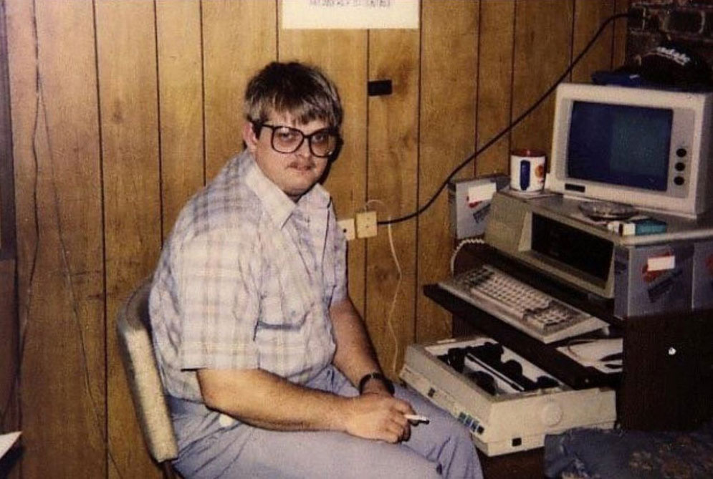
Intro to Self-Hosting and Homelabs
UCLA Linux Users Group
Winter 2025

Slide 2
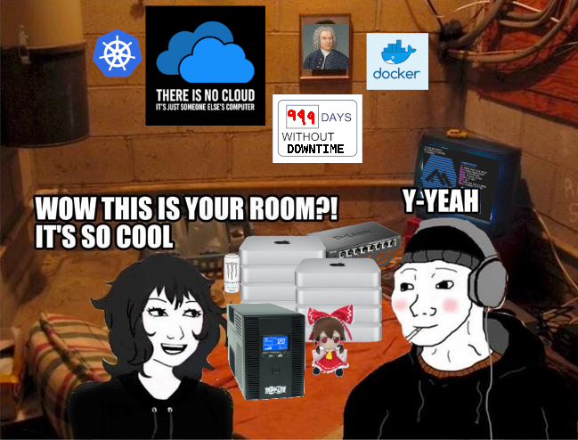
What is a Homelab?
Your very own server which you keep at home
As opposed to cloud computing
A great way to learn valuable sysadmin skills!

Slide 3
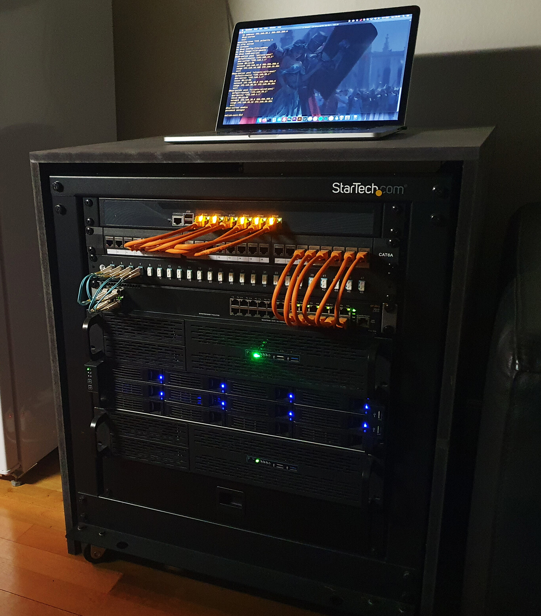
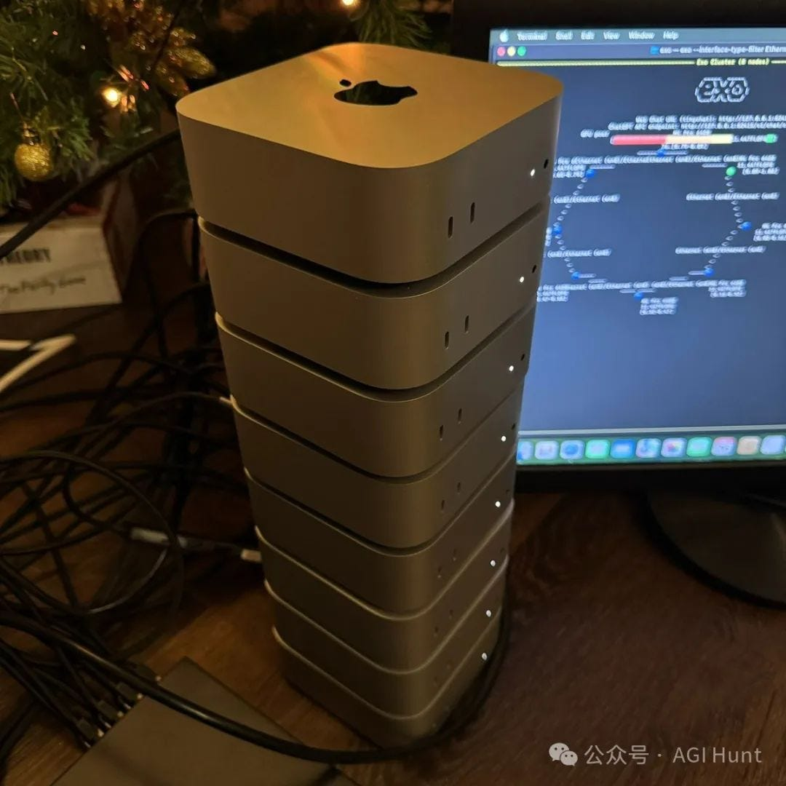
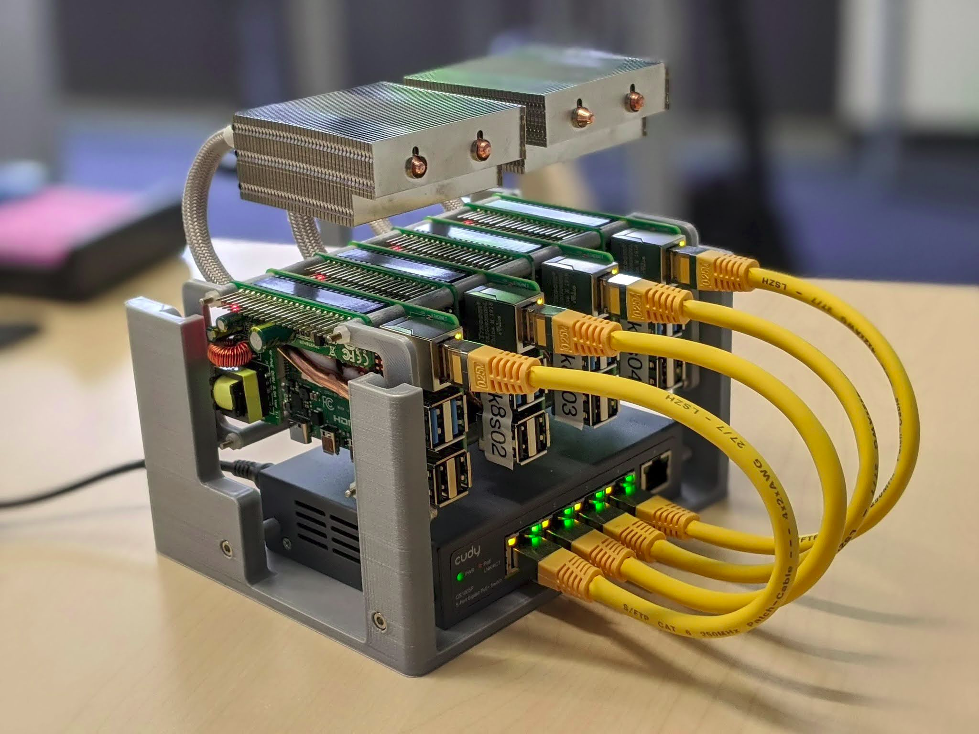
What are some examples?
Home servers can come in all shapes and sizes!

Slide 4
What are some examples?
Our club has our own server rack in Boelter Hall
Website: https://linux.ucla.edu
DNS
XMPP: Instant messaging (xmpp:main@room.linux.ucla.edu?join)
SuperTuxKart
Mumble: Voice chat
Virtual Machines for club members
Invidious: https://yt.linux.ucla.edu

Slide 5
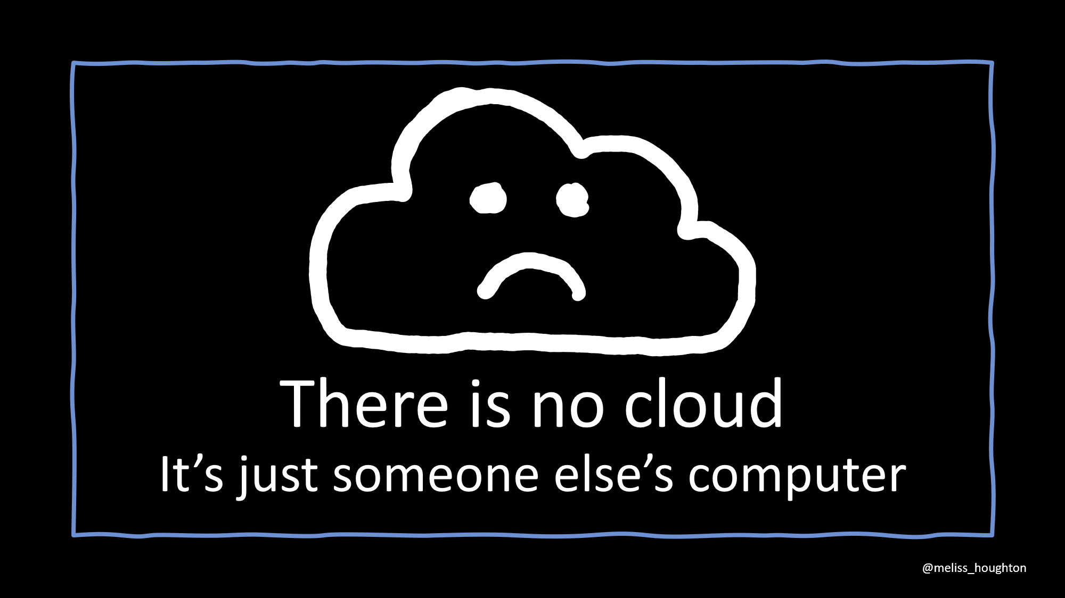
Why Self-Host?
Privacy, freedom
Ownership over your own data
Self-sufficiency
Cost-cutting
Learning experience
Bragging rights?

Slide 6
What things can I do with a homelab?
Host your own website and DNS
Run social media (fediverse) and video game servers
Make automated backups
Host your photo collections (Immich)
Stream movies (Jellyfin) and music (Subsonic, Icecast)
E-Mail (* dependent on ISP)
Support other decentralized services; i.e. cryptocurrency or Tor nodes
IP Cameras to monitor your stuff (orwell.linux.ucla.edu)
All made possible with the power of free software!
Was she a homelabber??

Slide 7
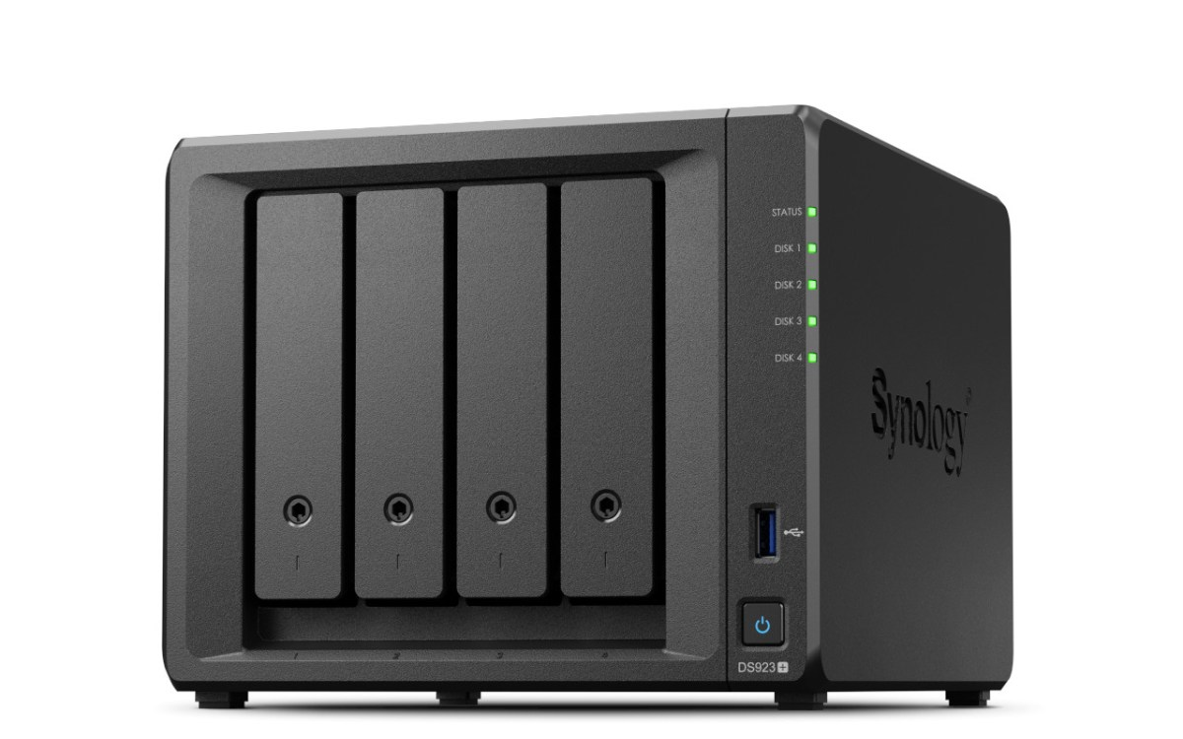
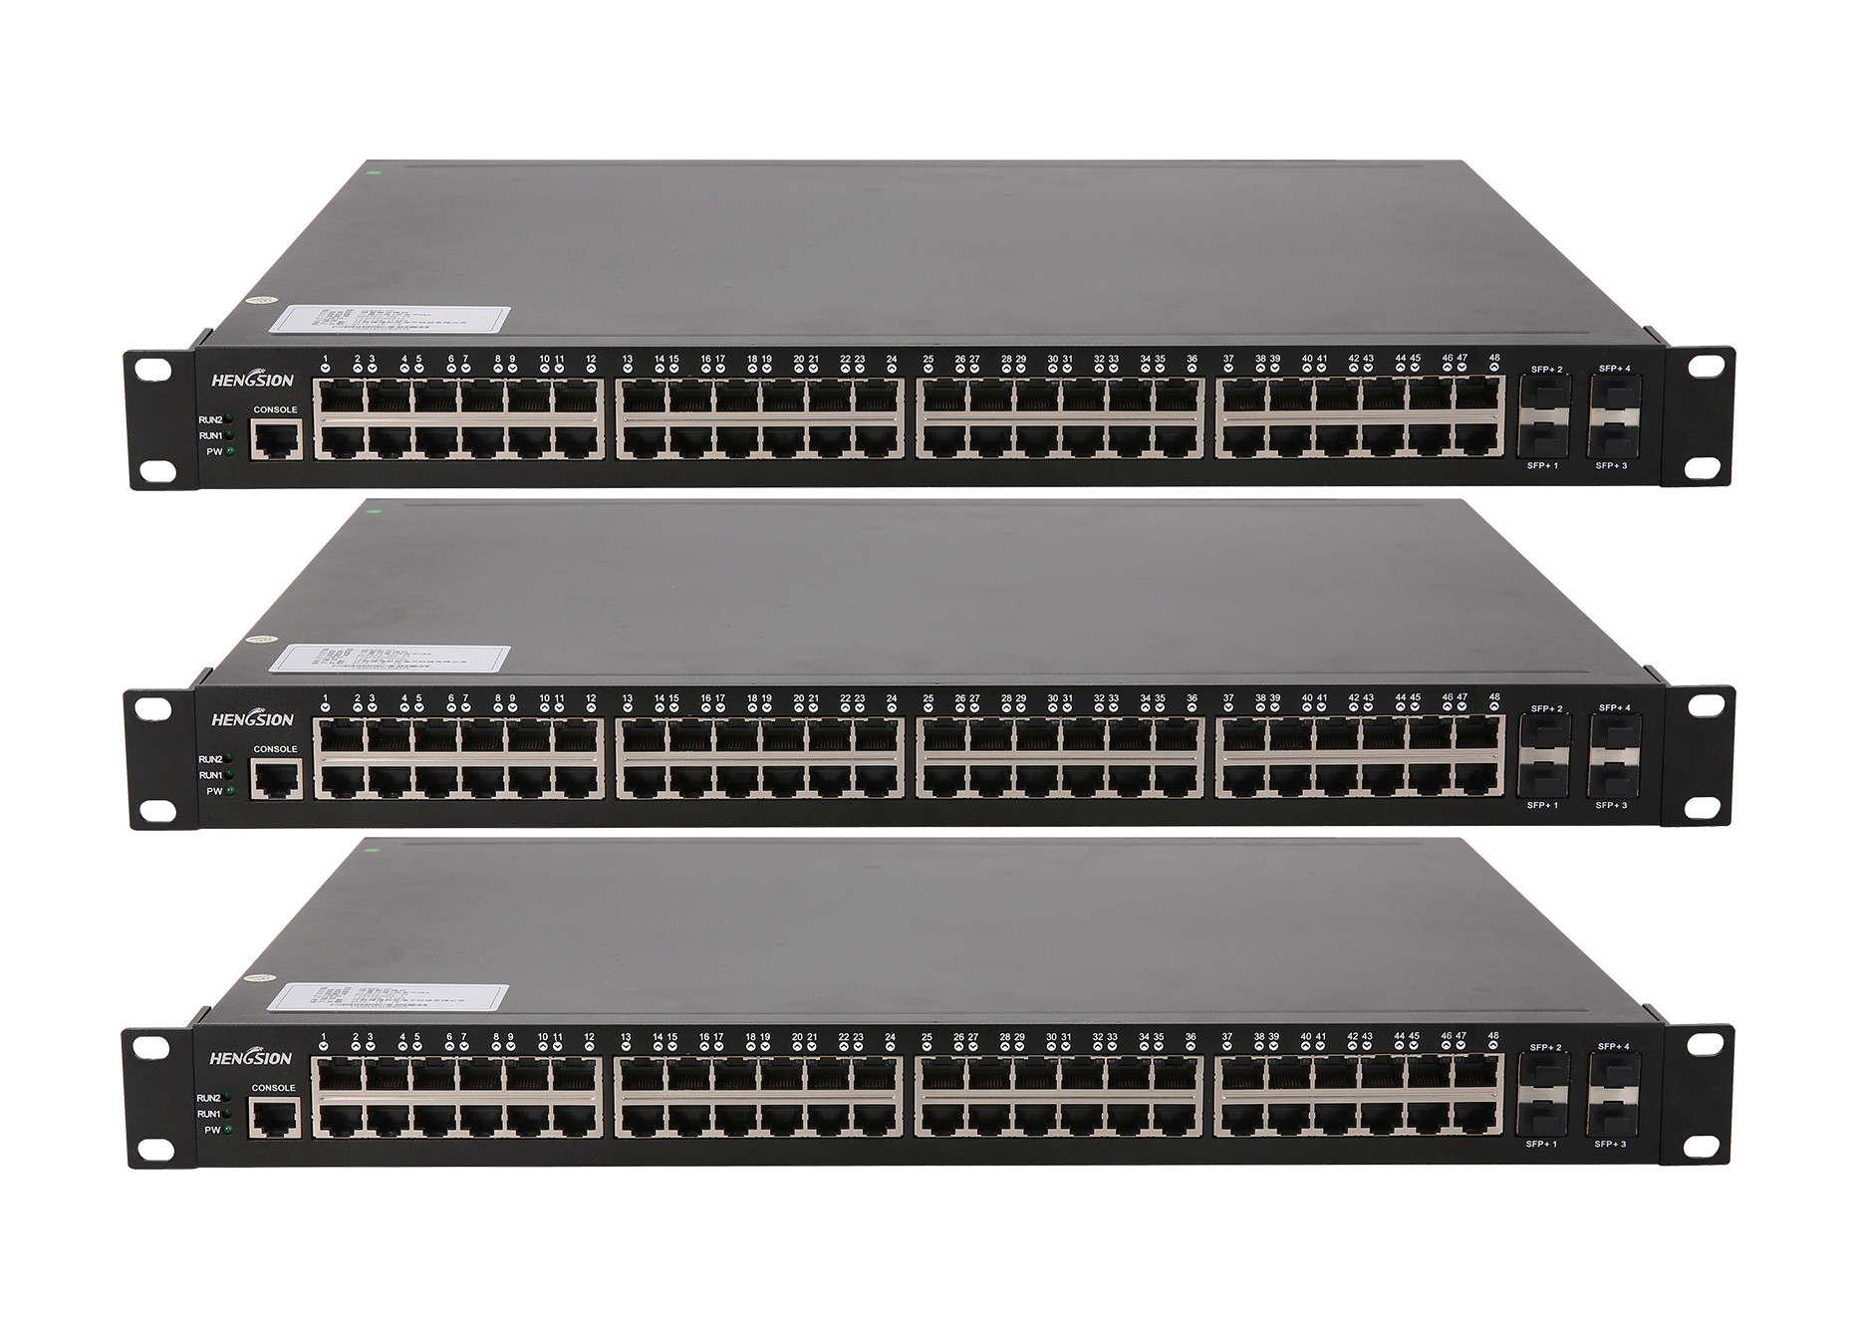
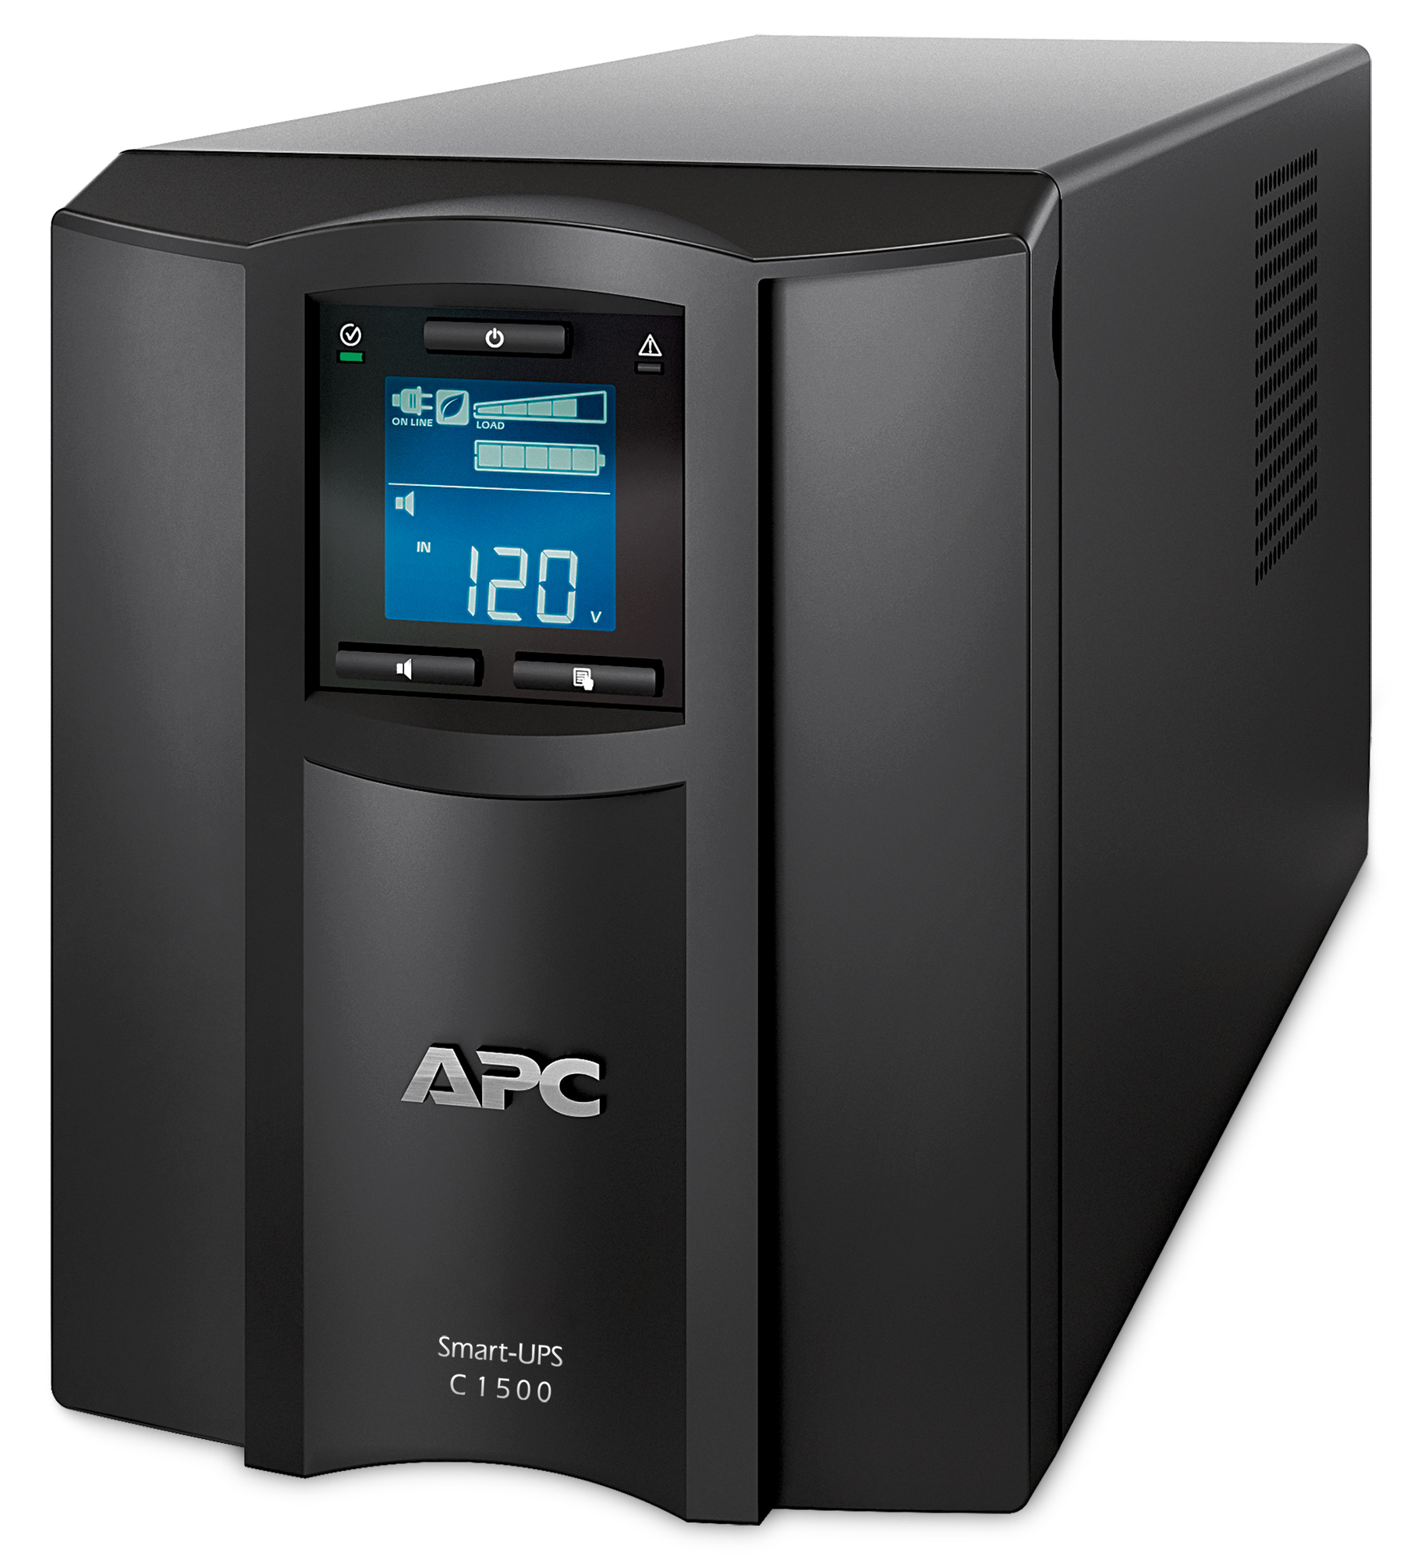
What do you need to start?
Low barrier to entry; you could start with e-waste hardware (wink wink)
Mandatory: a computer, router, Internet, electricity
Optional: domain name, rack, network switch, UPS, NAS

Slide 8
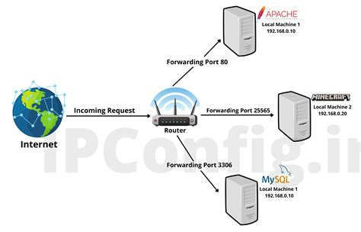
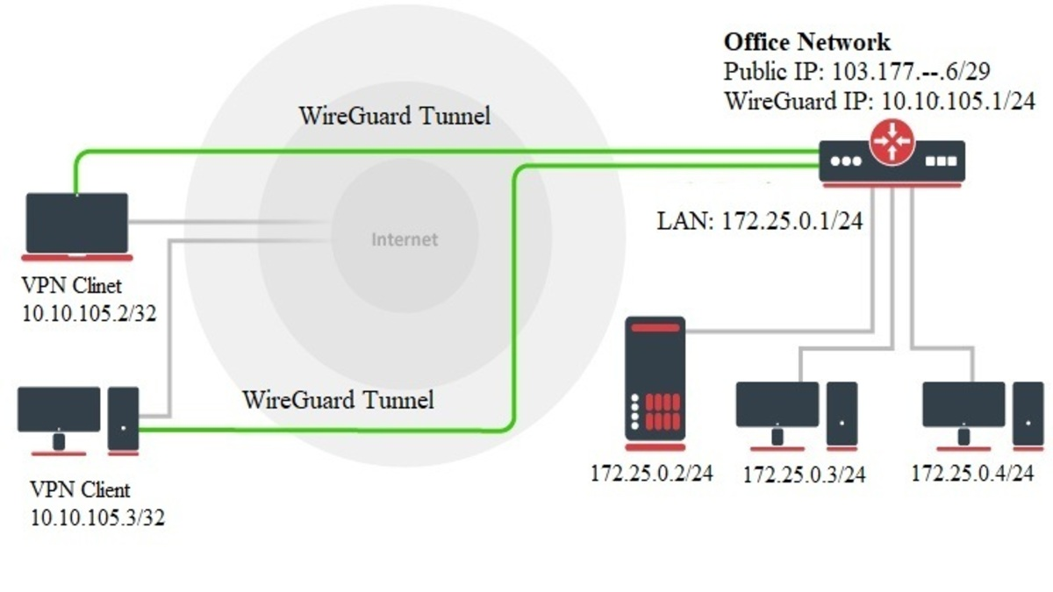
Setting up Networking
Port Forwarding
Opening ports on your router to expose certain services to the outside
HTTPS: port 443
SSH: port 22 (use public key authentication!)
VPN Servers
Securely access the internal network from the outside
SSH tunnelling has a similar effect
WireGuard

Slide 9
Setting up Networking
Domain Name (i.e. nijika.org)
Easier to remember than an IP address
Purchased from a domain registrar
Namecheap
Certain TLDs (like “.jp”) have restrictions on who can register
DNS records: translate domain name to your IP address
Get your public IP address: curl https://icanhazip.com
“A” record for IPv4, “AAAA” for Ipv6
Additional records needed for subdomains, email security, Let’s Encrypt HTTPS challenge
Home networks won’t have a static IP, so use dynamic DNS

Slide 10
Setting up Storage
Fancy: dedicated NAS
Simple: add more hard drives to your server lol
Use NFS on Linux, or SFTP to make a network share
RAID configurations
Striped
Mirrored
Make regular backups

Slide 11
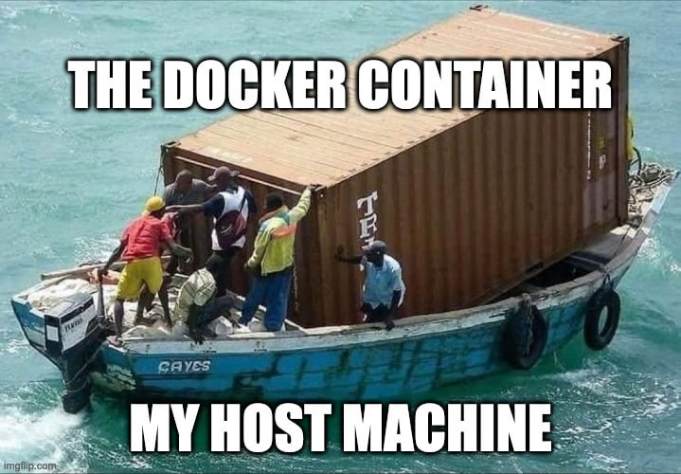
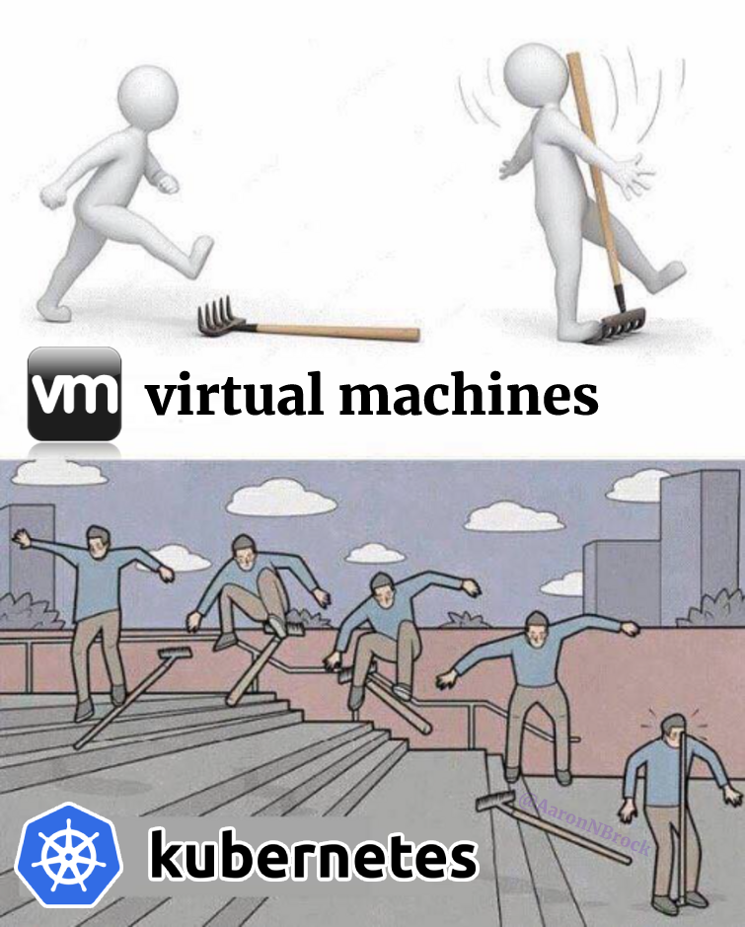
Setting up the OS
Start by installing Linux! (duh)
Easy: YunoHost
Moderate: Docker containers, Proxmox VMs
Hard: Kubernetes
Allows you to make server clusters!
Docker containers have less overhead than VMs

Slide 12
That’s it for now!
Thanks for listening!

Slide 13
Q&A

