Slide 1
Privacy and OPSEC for Linux Nerds
UCLA Linux Users Group
Winter 2025 Week 8

Slide 2
Overview
Topics We’ll Be Covering
Why Should you Care?
Threat Modeling
Avoiding Online Trackers
Common Spyware and "Botnets"
Actually Private Chat Apps
Self-Hosting for Privacy
Operations Security
Hardening your Phone
Hardening your Computer
Full-Disk Encryption
Cryptocurrency
The Tor Network
Knowing your Rights

Slide 3
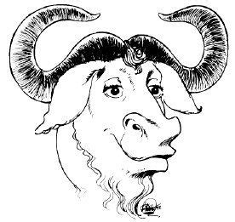
Why Care About Privacy?
Reason #1
Did you know?
A significant portion of Linux users and free software enthusiasts are schizophrenics who are highly distrustful of corporations and the government.

Slide 4
Why Care About Privacy?
Reason #2
Even if you aren't a criminal…
Federal law enforcement agencies, colloquially known as "glowies", are not your friend.
NSA wiretapping phones w/o warrants
FBI spying on civil rights leaders
CIA's Project MKUltra
DOD's false flag Operation Northwoods
ATF's Waco and Ruby Ridge Sieges
ATF knowingly allowing gun sales to cartel members
Feds and local police misidentifying suspects with facial recognition

Slide 5
Why Care About Privacy?
Reason #3
But I don't have anything to hide…
There are many legitimate reasons to want more privacy:
No more creepy targeted ads
Resisting electronic discrimination or profiling
Protecting your identity from hackers and criminals
Whistleblowing
Hiding from stalkers/abusive partners
… or purely as a lifestyle choice.

Slide 6
How do you start reclaiming your digital privacy?

Slide 7
Choosing a Threat Model
Your Roommates
You don't want them to find your "homework" folder
Solution: password-protect your PC, lock your door, encrypt files

Slide 8
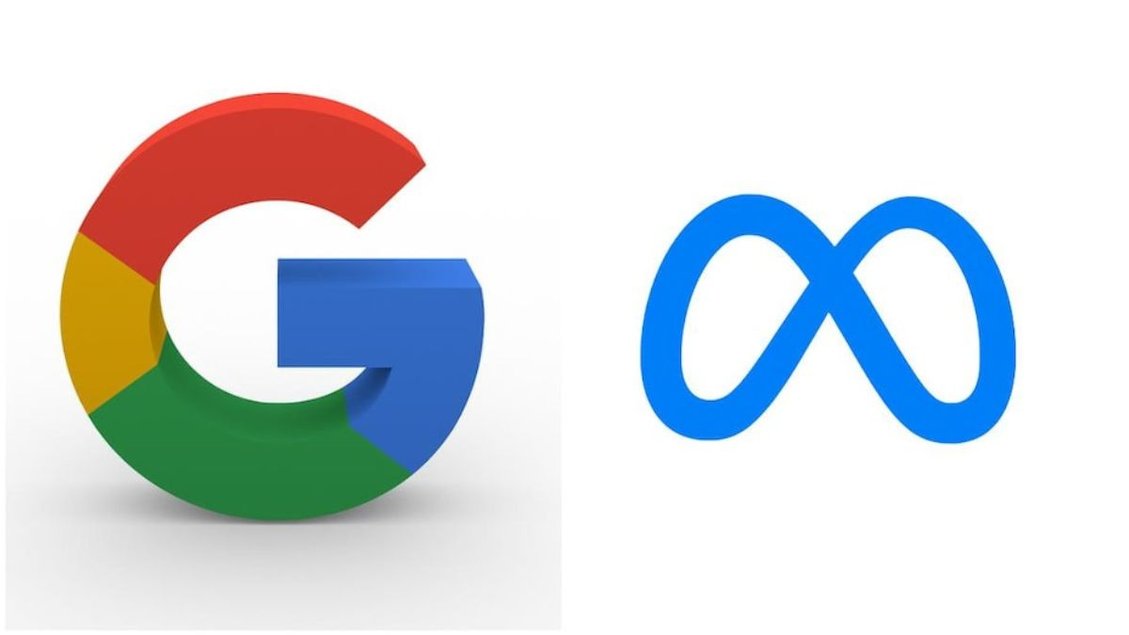
Choosing a Threat Model
Your Roommates
Google and Meta
You don't want them to find your "homework" folder
Solution: password-protect your PC, lock your door, encrypt files
You don't want your web browsing activity to be tracked
Solution: use open-source software, browser extensions, burner accounts

Slide 9
Choosing a Threat Model
Your Roommates
Google and Meta
The CIA
You don't want them to find your "homework" folder
Solution: password-protect your PC, lock your door, encrypt files
You don't want your web browsing activity to be tracked
Solution: use open-source software, browser extensions, burner accounts
You want to be invisible to the government
Solution: encrypt everything, browse Tor, run Tails/Qubes, leave no trace, don't even carry a phone
There's a tradeoff between convenience and anonymity, but it's easy to get started!

Slide 10
What's the best software to run?

Slide 11
Chat Applications
Discord, WhatsApp
Discord has no end-to-end encryption (E2EE) and scans your pics
WhatsApp claims to have E2EE, but actually reveals messages to Meta if someone reports it

Slide 12
Chat Applications
Discord, WhatsApp
Signal, Session
Discord has no end-to-end encryption (E2EE) and scans your pics
WhatsApp claims to have E2EE, but actually reveals messages to Meta if someone reports it
Signal's server code is not fully open-source, but independent security auditors vouch for it
Signal requires your phone number
Session uses anonymous IDs

Slide 13
Chat Applications
Discord, WhatsApp
Signal, Session
XMPP, SimpleX Chat
Discord has no end-to-end encryption (E2EE) and scans your pics
WhatsApp claims to have E2EE, but actually reveals messages to Meta if someone reports it
Signal's server code is not fully open-source, but independent security auditors vouch for it
Signal requires your phone number and is centralized
Session uses anonymous IDs
XMPP is fully open-source and decentralized – compare with Matrix
XMPP clients can be lacking sometimes
SimpleX has no user IDs, is open-source and decentralized

Slide 14
Social Media
Instagram, X
Instagram has E2EE in DMs, but is owned by Meta, soo…
X requires you to log in for most things
Both track you using 3rd party cookies on other sites
Algorithms learn your habits

Slide 15
Social Media
Instagram, X
Mastodon
Instagram has E2EE in DMs, but is owned by Meta, soo…
X requires you to log in for most things
Both track you using 3rd party cookies on other sites
Algorithms learn your habits
No algorithm or tracking
Decentralized (federated) and open-source
Run your own instance for ownership over your data

Slide 16
Social Media
Instagram, X
Mastodon
No/Inactive Social Media
Instagram has E2EE in DMs, but is owned by Meta, soo…
X requires you to log in for most things
Both track you using 3rd party cookies on other sites
Algorithms learn your habits
No algorithm or tracking
Decentralized (federated) and open-source
Run your own instance for ownership over your data
If you stop using social media today, companies can no longer track you
Less potential for oversharing/opsec violations
Improved mental health

Slide 17
Browsers and Extensions
Firefox
Brave Browser
Pros: With the right extensions and user.js, one of the most private browsers
Cons: Has some annoying sponsorships, which can be turned off
Pros: Privacy-respecting by default; based on Chromium
Cons: Crypto shilling; based on Chromium…
uBlock Origin
NoScript
Ad and tracker blocker for most browsers
Protects against suspicious links
Can use custom blocklists
Disables suspicious JavaScript and media embeds
Protects against XSS attacks
Enabled in Tor Browser by default
Not always practical
Does not stop other kinds of fingerprinting

Slide 18
Ways you can be deanonymized by websites
Demo: https://noscriptfingerprint.com/
User Account Activity
IP Address
Third-Party Cookies
Device APIs
User-Agent String
Canvas Fingerprinting

Slide 19
The Most Secret Way to Browse the 'Net
The Dark Web
Tor
Decentralized, encrypted network that bounces traffic across several worldwide servers
Can browse the normal Internet (clearnet) or hidden services (.onion)
Browser based off of Firefox
Websites use basically no JavaScript
Highly illegal stuff happens on here so you know it's good :^)
Promising Alternatives
I2P
Far more decentralized than Tor
Lokinet
Supposed to be faster and easier than Tor

Slide 20
If you care about your privacy…
stop using proprietary software and start self-hosting!

Slide 21
What lifestyle habits can help maintain our anonymity?

Slide 22
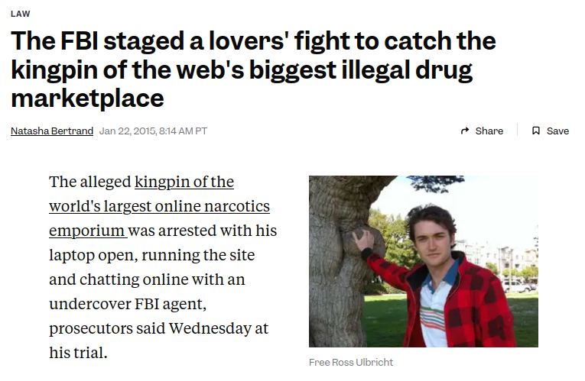
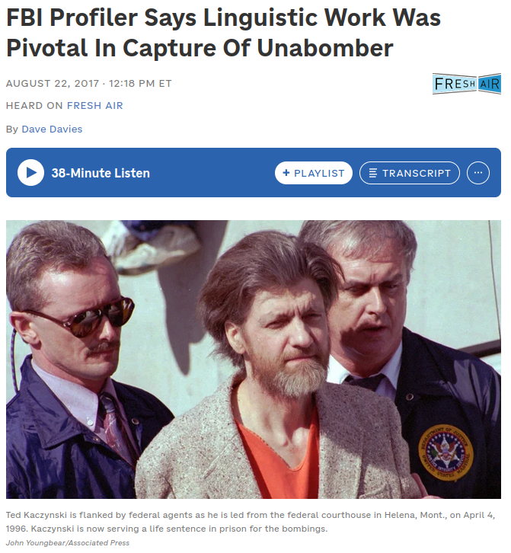
Operations Security (OPSEC)
"Loose lips sink ships"
IRL
Make sure no one is eavesdropping
Screen privacy shields
Turn off your computer when you get up!
Online
Don't talk about personal details
Use a new identity for everything
Be extremely careful with pictures
Street signs, browser tabs, laptop model, etc. could all be used to identify you
Expert mode: use different writing styles?!

Slide 23
What's the worst that could happen?

Slide 24
Open Source Intelligence (OSINT)
Also known as "weaponized autism"
“A Japanese man accused of stalking and sexually assaulting a young pop star told police he located her through the reflection in her eyes in a picture, according to local media reports. The man said he had identified a train station reflected in the singer's eyes in a selfie she posted online.
The 26-year-old then waited at the station until he saw his victim and followed her to her home, police said.” https://www.bbc.com/news/world-asia-50000234

Slide 25
How can I ensure my devices are as secure as possible?

Slide 26
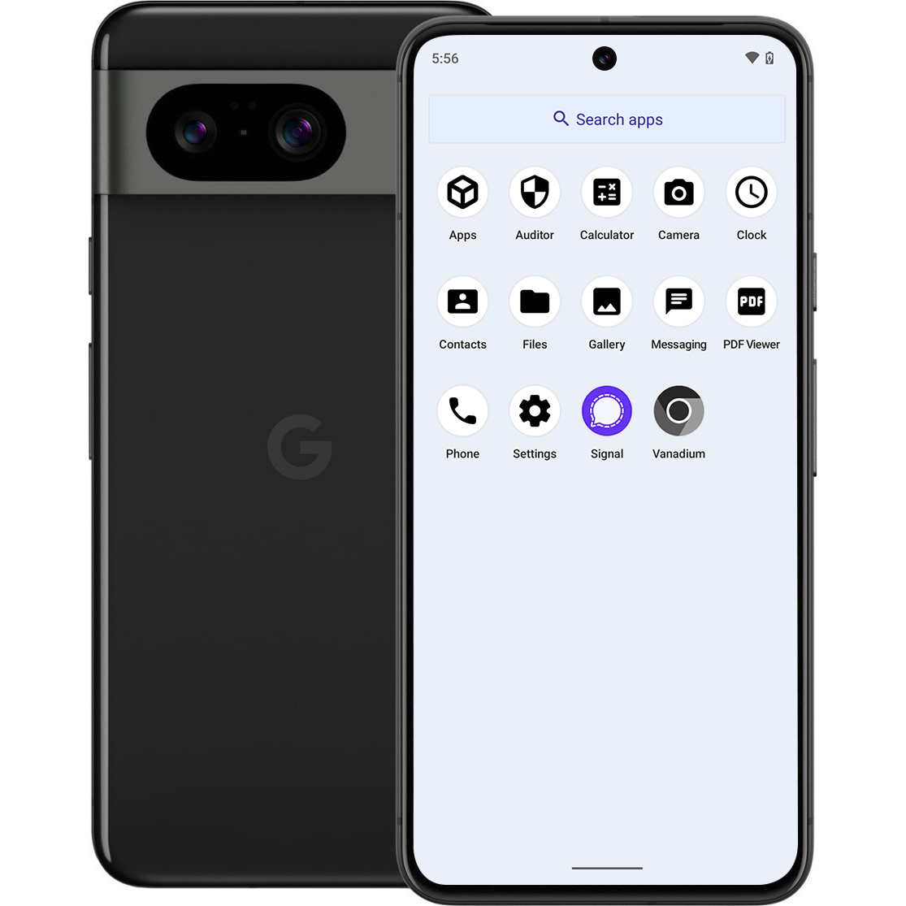
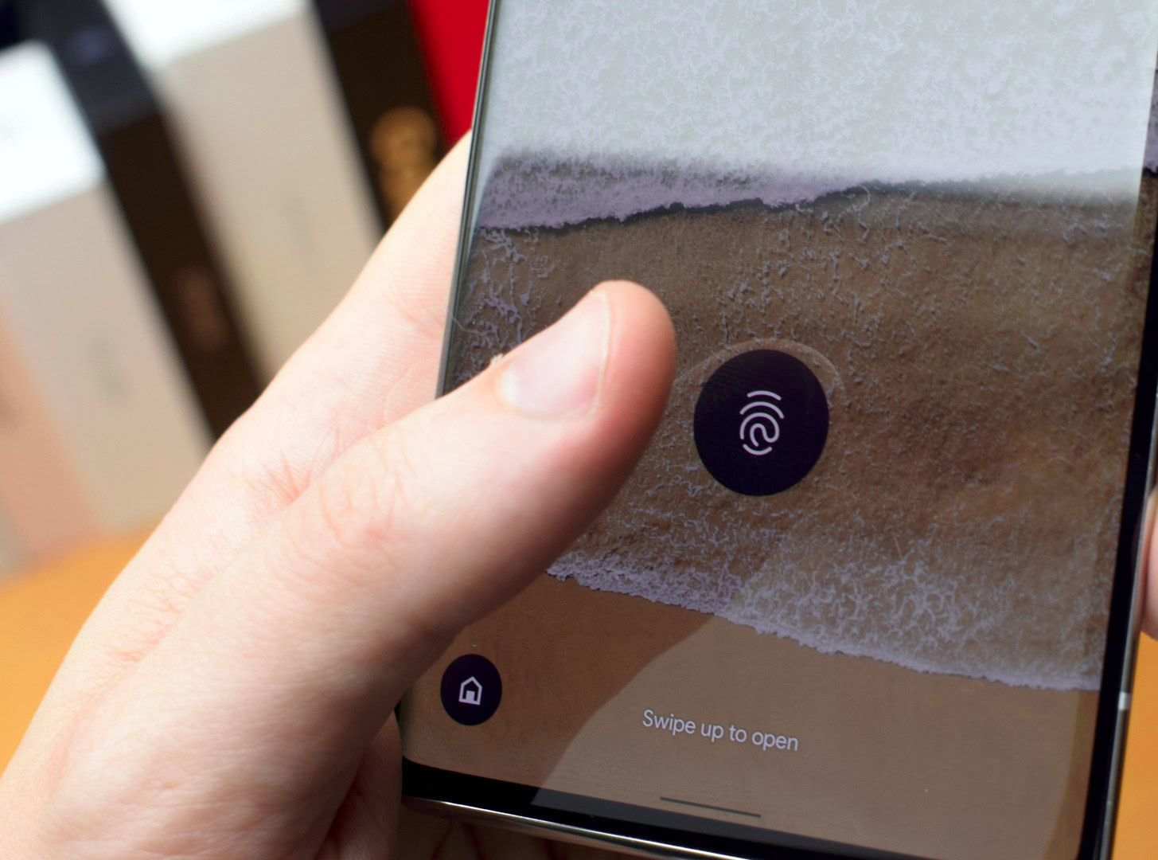
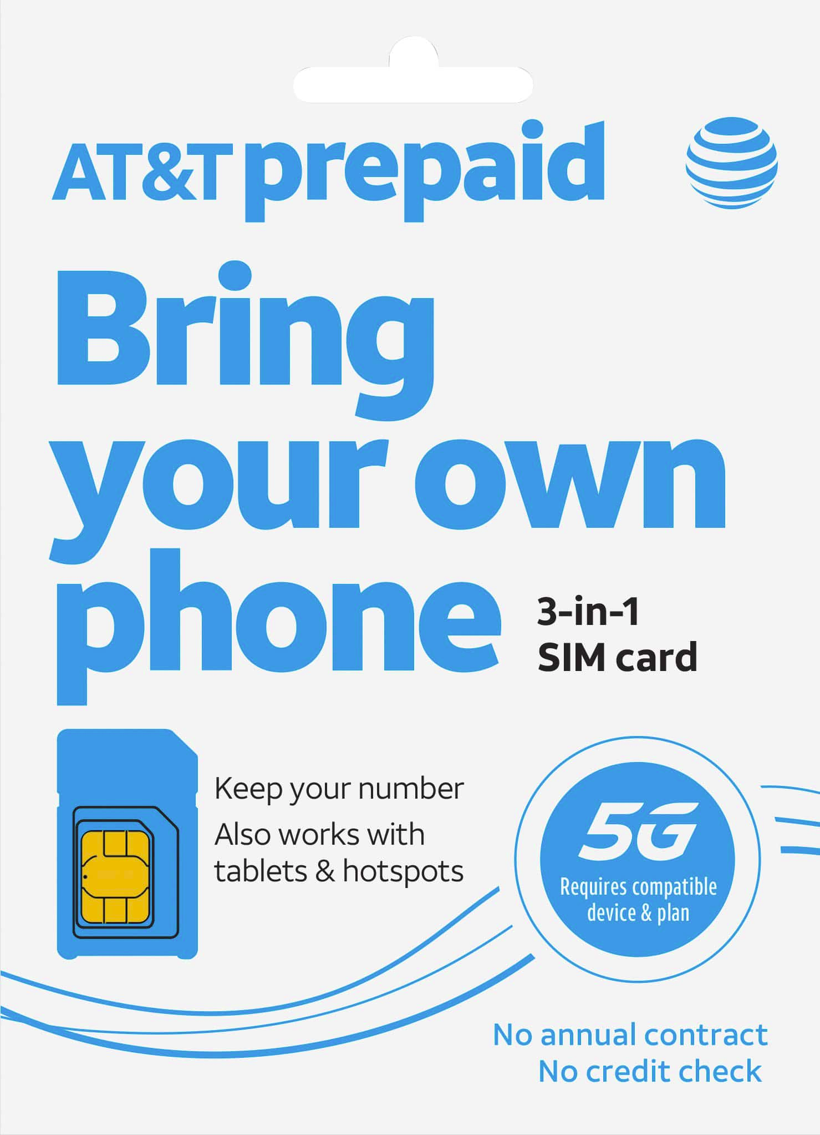
Hardening your Phone
Google Pixel + GrapheneOS
Prepaid SIM
Non-biometric authentication
GrapheneOS is the most secure Android custom ROM by far
Install apps from F-Droid only
Apple isn't evil per se, but still flawed
iCloud almost had CSAM image fingerprinting
Buy prepaid phone plans with cash
JMP.chat offers an eSIM with Verizon network + XMPP texts/calls, accepts crypto
It's best to avoid using cell towers at all
Biometric information is not protected under the 5th Amendment

Slide 27
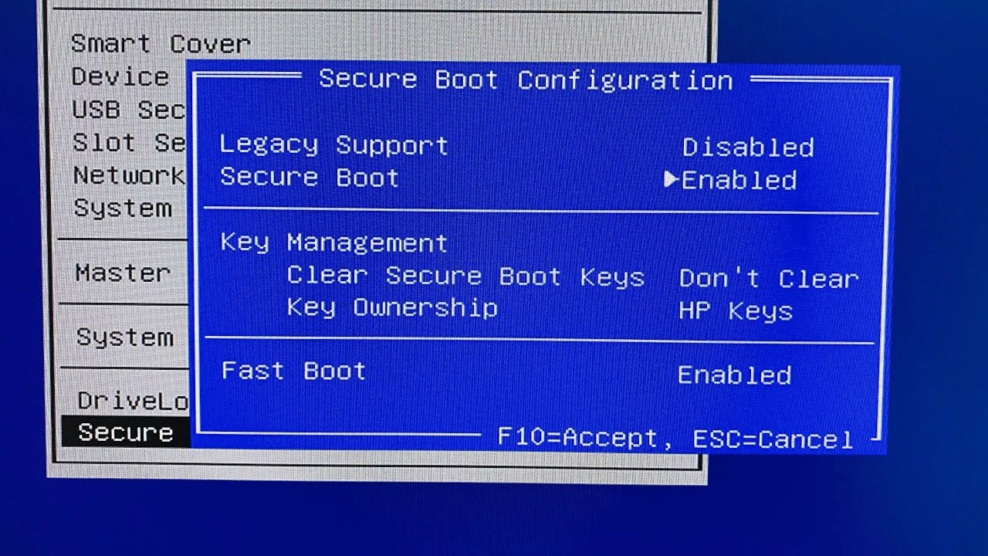
Hardening your PC
Full Disk Encryption
Secure Boot
coreboot
Ensures all your data is encrypted at rest, but no guarantees when system is on
BIOS setting which prevents tampering and ensures you only boot from signed images. Preferably uses your own keys.
Open-source replacement for proprietary blobs in your system's BIOS or UEFI firmware
**Not universally supported, and for advanced users only**

Slide 28
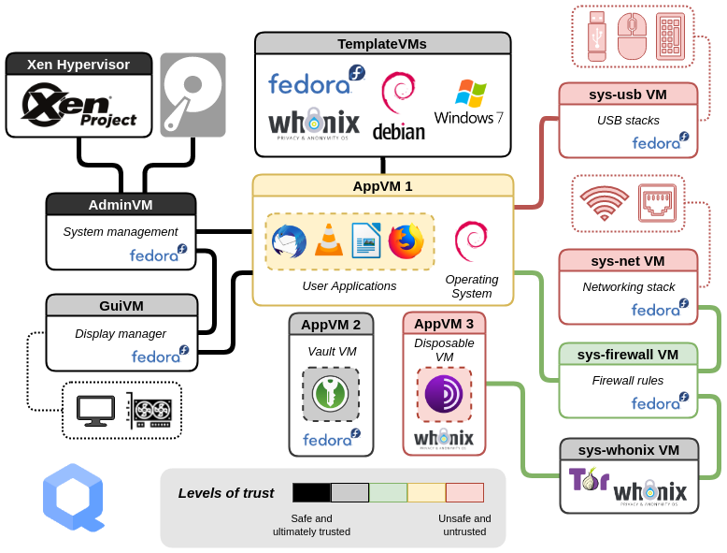
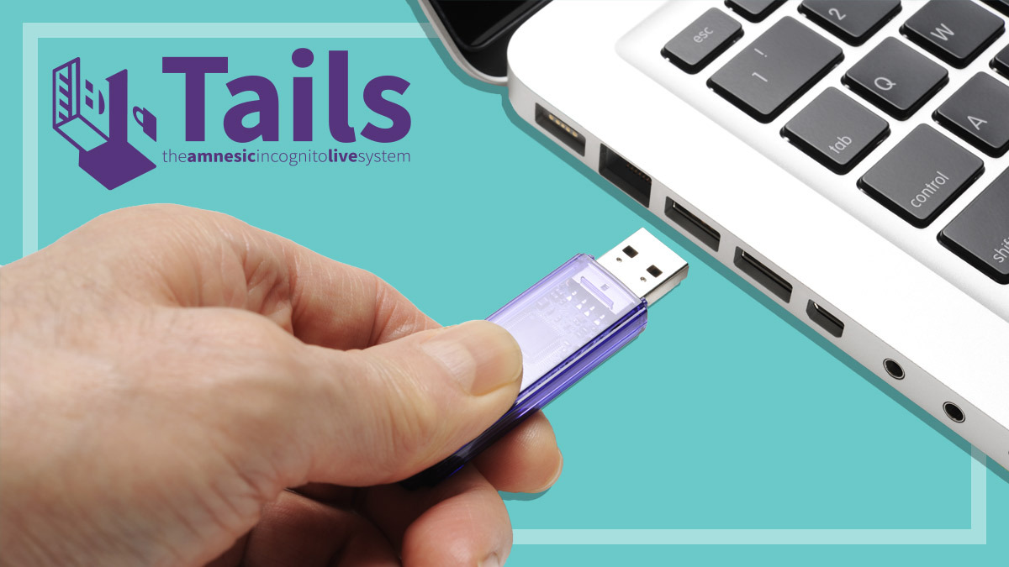
Hardening your PC Even More
Linux Distros for MAXIMUM Secrecy
Qubes OS: isolate EVERYTHING in containers!
Tails: bootable USB stick that leaves no data behind!
All network traffic routed through Tor

Slide 29
We can go deeper…
Not even your CPU is safe!

Slide 30
Q: Why is Monero (XMR) the best cryptocurrency?
A: Because it has an anime girl mascot.

Slide 31
Reasons to use Monero
Feds HATE this one simple trick!
Unlike Bitcoin, every transaction is private
Sender, receiver, and amount are hidden
Monero cannot be traced, making the currency fungible (no “dirty” money)
Decentralized and open source
Mining algorithm optimized for CPUs, making ASICs not profitable
Ensures that it can only be run on commodity hardware
Recommended to run your own node to prevent deanonymization attacks
Be wary of cryptocurrency exchanges which comply with Know-Your-Customer laws!
Monero can atomic swap with Bitcoin now
Used for highly illegal stuff, so we know it's good :^)

Slide 32
Doesn't this technology just enable criminals?
What legal things can you even do anonymously these days?

Slide 33
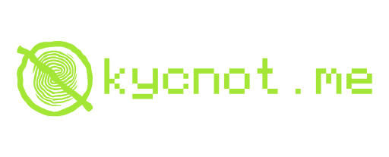
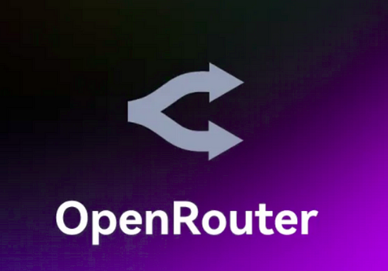
Legitimate Uses of Monero
Rent Your Own Server
NanoGPT / OpenRouter
What else?
Kyun.host accepts payment in Monero and collects no data on you
(There are several other services like it, but I like the aesthetics)
Talk to all the latest paid AI models without having your requests logged!
VPNs and anonymous phone numbers and…
Do your own research! I suggest https://kycnot.me
Double-check the privacy policy always!

Slide 34
Final Notes

Slide 35
Know Your Rights (U.S. Edition)
4th Amendment
The right of the people to be secure in their persons, houses, papers, and effects, against unreasonable searches and seizures, shall not be violated, and no Warrants shall issue, but upon probable cause, supported by Oath or affirmation, and particularly describing the place to be searched, and the persons or things to be seized.

Slide 36
Know Your Rights (U.S. Edition)
Miranda Rights
Miranda rights are legal rights that police must inform a suspect of when they are in custody and about to be interrogated. These rights include the right to remain silent and the right to an attorney, ensuring protection against self-incrimination.

Slide 37
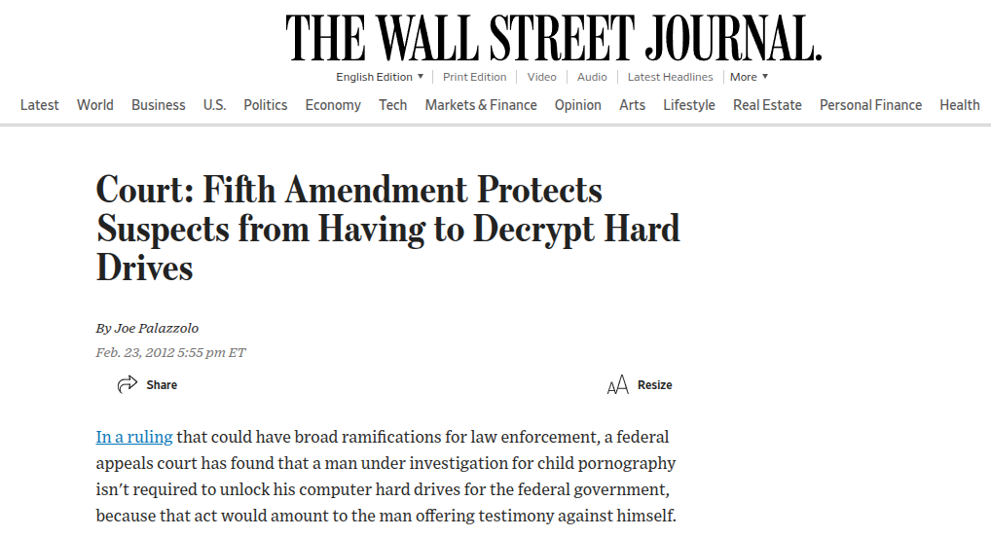
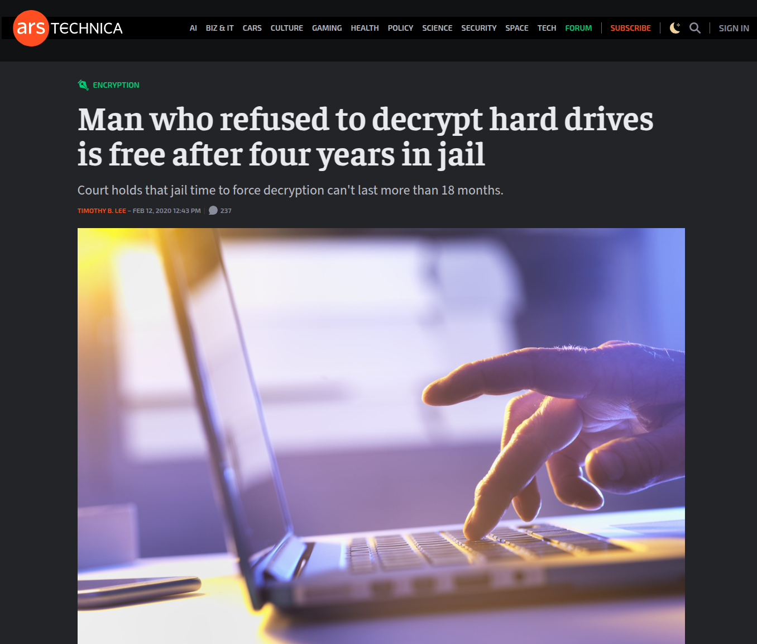
Know Your Rights (U.S. Edition)
5th Amendment
… nor shall [any person] be compelled in any criminal case to be a witness against himself, nor be deprived of life, liberty, or property, without due process of law; nor shall private property be taken for public use, without just compensation.

Slide 38
Know Your Rights (U.S. Edition)
Limits to the 5th Amendment
The “forgone conclusion rule” applies “where the existence and location of the [documents sought] are a foregone conclusion and the [defendant] adds little to nothing to the sum total of [plaintiff’s] information by conceding that he in fact has the [documents]” and, therefore, compelling production “does not touch upon constitutional rights.” (United States v. Sideman & Bancroft (9th Cir. 2013) 704 F.3d 1197, 1202.)

Slide 39
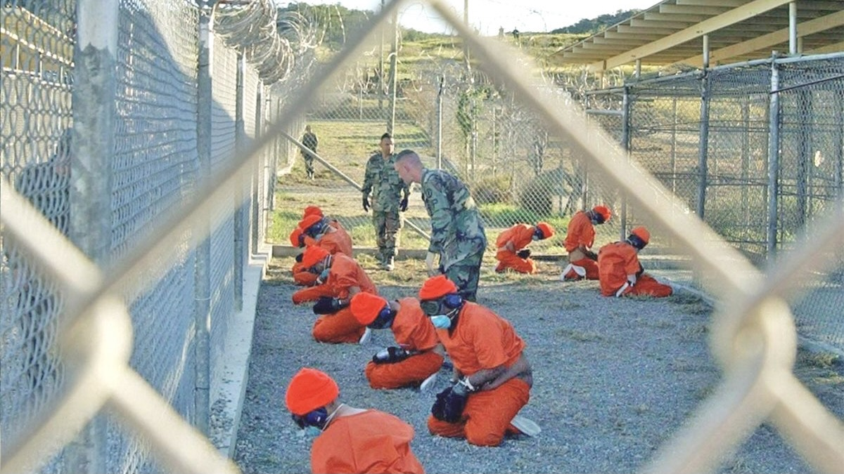
Know Your Rights (U.S. Edition)
Habeas Corpus
A writ of habeas corpus is a legal order that requires a person holding another in custody to bring the detainee before a court to determine if the detention is lawful. It serves as a protection against unlawful imprisonment.

Slide 40
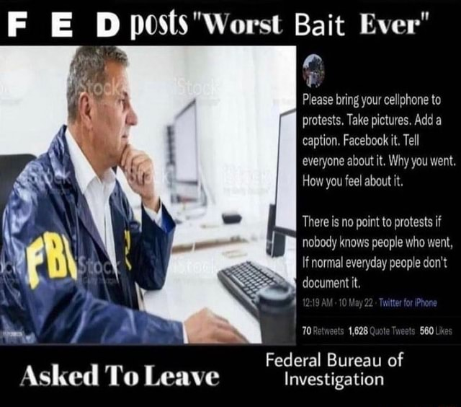
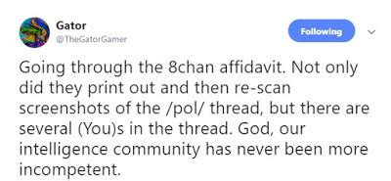
Know Your Rights (U.S. Edition)
Entrapment
You can't be convicted of a crime that the cops enticed you into doing if you wouldn't have otherwise done it.
Undercover law enforcement agents encouraging criminal activity is colloquially known as fedposting.

Slide 41
Resources
For learning more about privacy
NGOs
EFF (Electronic Frontier Foundation)
Wikis
InstallGentoo Wiki
Various resources on Tor (e.g. Dread)
YouTubers
Mental Outlaw
Luke Smith (inactive)

Slide 42
Any Questions?

