Slide 1
Gaming on Linux
UCLA Linux Users Group
Spring 2025 – Week 4

Slide 2
The “Gaming on Linux” Myth
Oftentimes you’ll hear Windows users say:
“I want to try Linux, but I can’t play games on it.”
That’s usually a cope, or they haven’t done their research.
I’m here to dispel this myth once and for all!

Slide 3
“Linux Has No Games”
Meanwhile, in PS5 land...

Slide 4
So What Options are There?

Slide 5
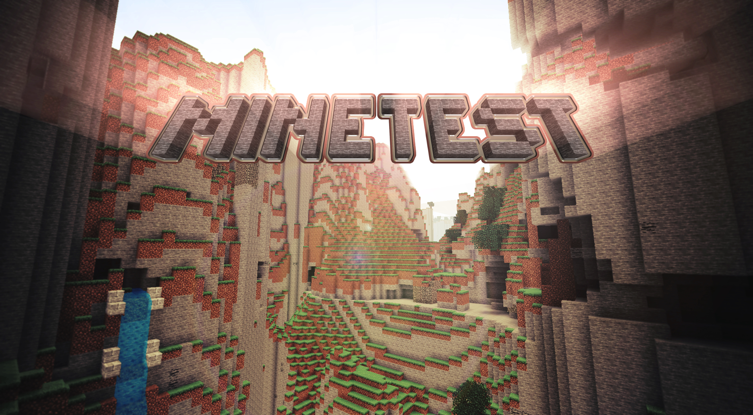
Original Titles
Not the most recognizable names, but we gotta show some love for Free Open-Source Software!
SuperTux: Mario-like platformer
SuperTuxKart: play w/ us on the LUG server!
Minetest: Minecraft clone with more extensibility
osu!: weebs and rhythm game fans will know this one. Based on .NET.
There’s actually tons of them at https://wiki.archlinux.org/title/List_of_games

Slide 6
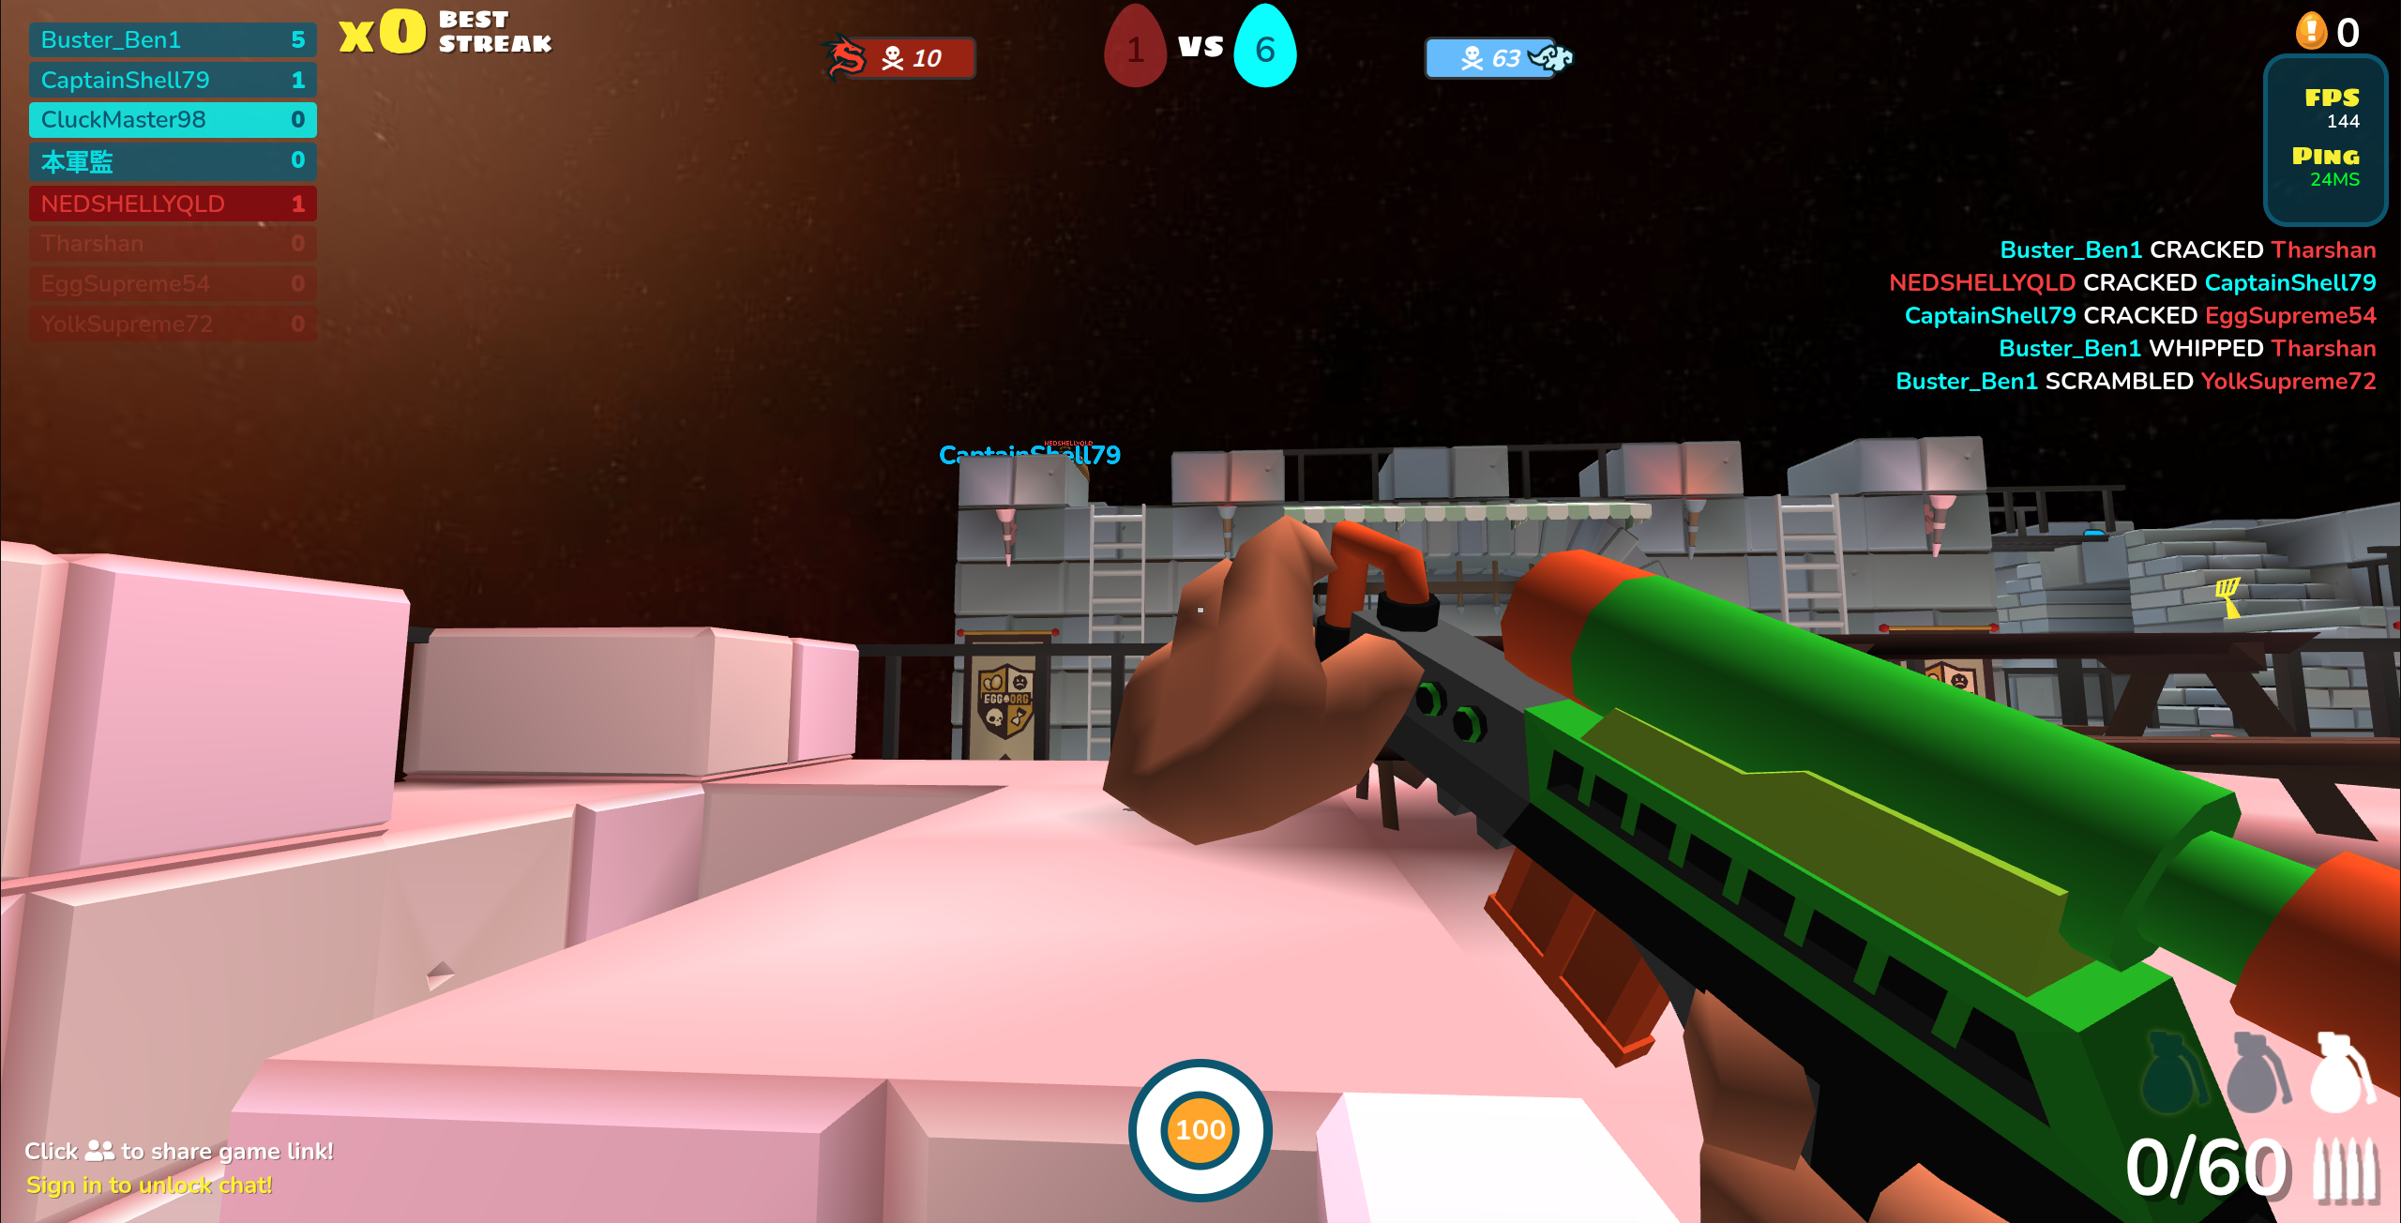
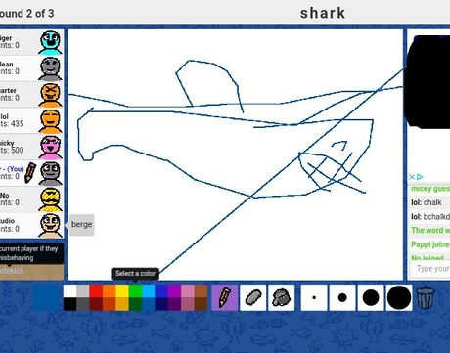
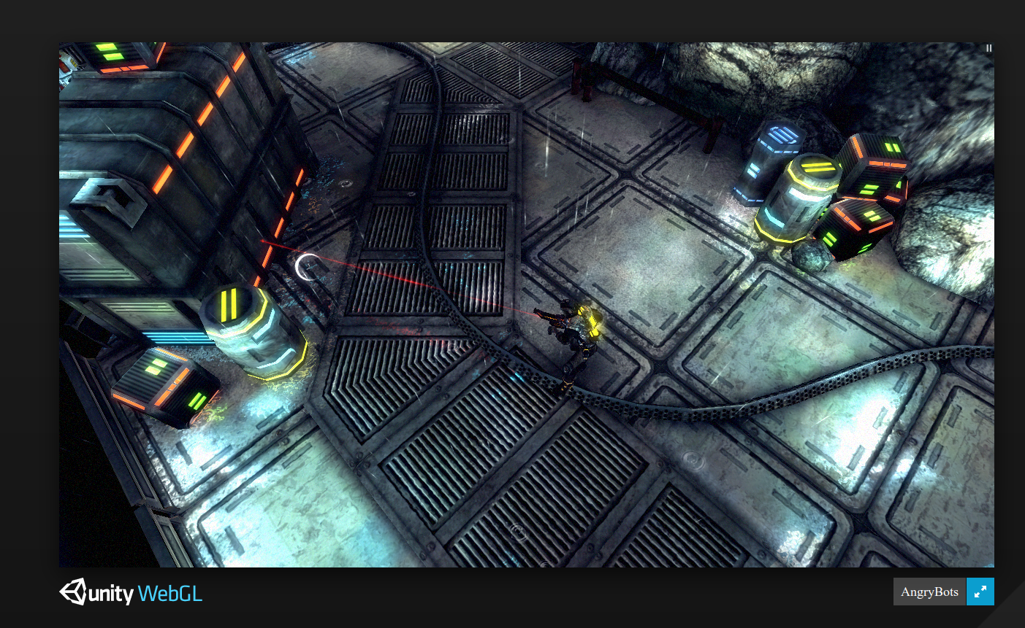
Browser Games
It goes without saying that these run on every OS
Core webdev languages: JavaScript, HTML, CSS
3D browser-native games are often WebGL-based
Shellshockers (shellshock.io)
Simple 2D graphics can use the Canvas API
Dinosaur game (chrome://dino)
Skribbl (skribbl.io)
Unity games can be built for browsers with WebAssembly
https://files.unity3d.com/jonas/AngryBots/
There’s also this new API called WebGPU?!
You: Ok… but these aren’t real games. Anything I can play on a Chromebook isn’t a video game ffs.

Slide 7
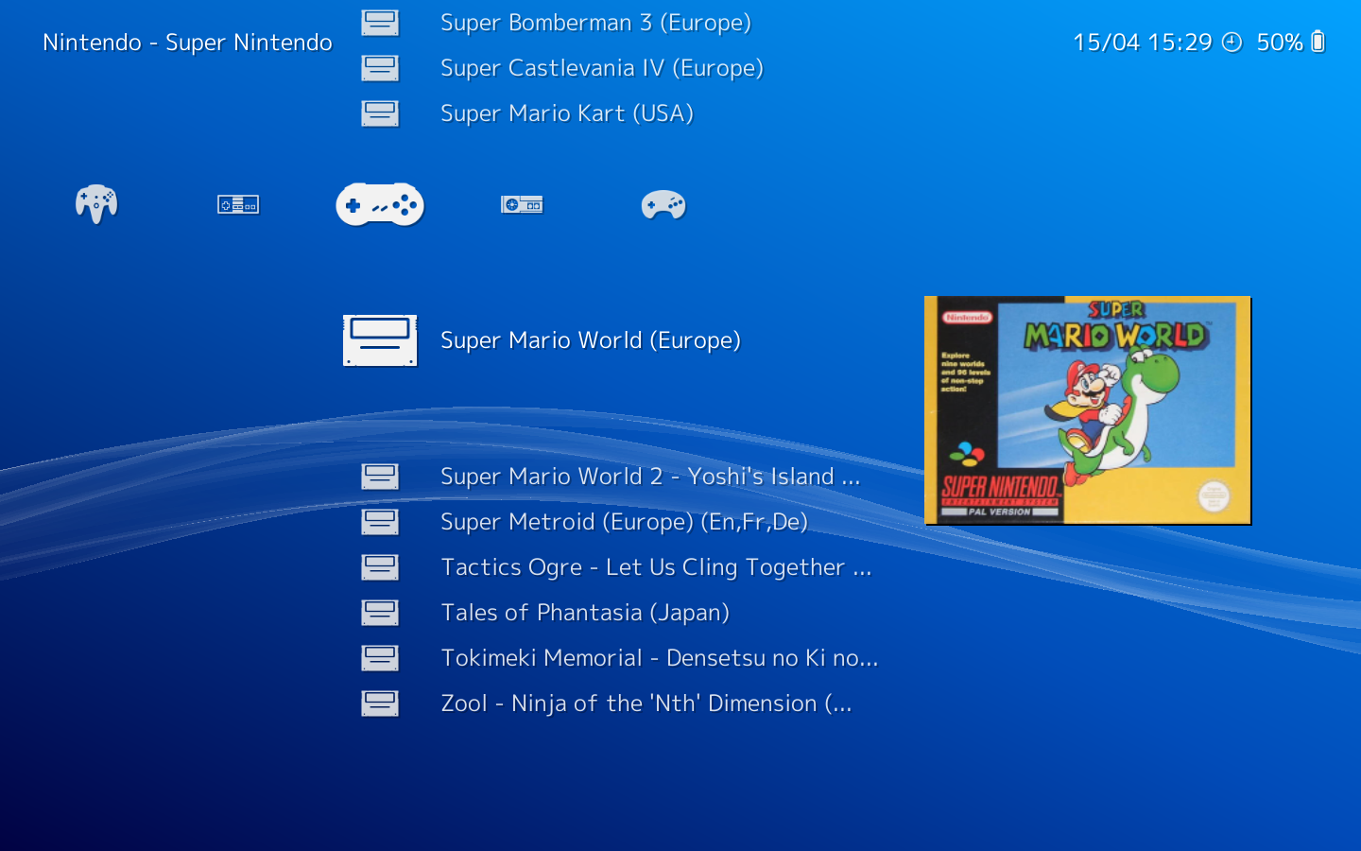
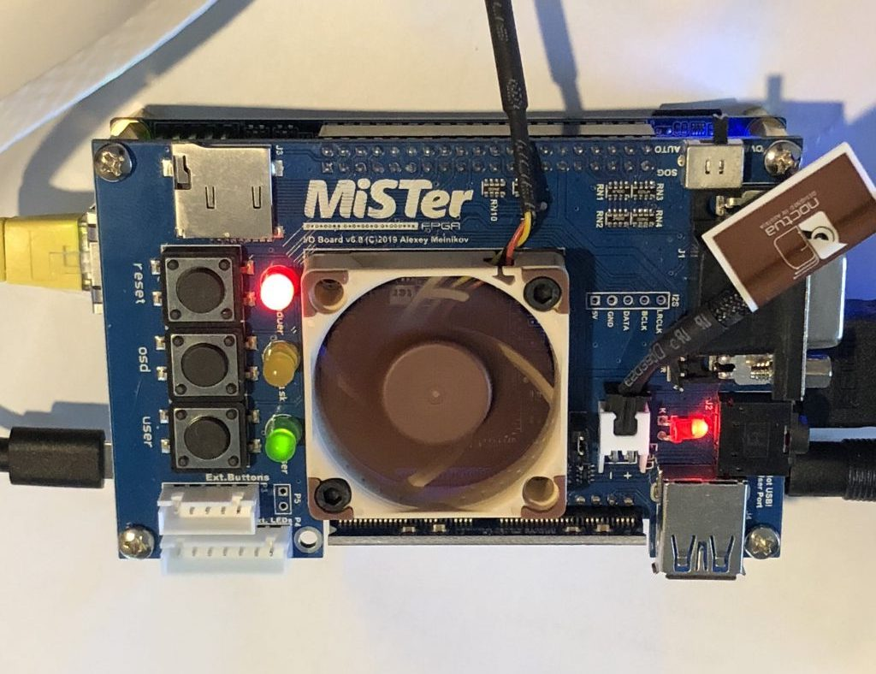
Emulation
Play console games on your PC
… as long as you’re OK with sailing the seven seas 🏴‍☠️
Software emulators: seemingly all available on Linux
Snes9x, Citra, DeSmuME, Dolphin, Yuzu, RPCS3
RetroArch: frontend that works with various SW emulators
RetroPie: OS for Raspberry Pi bundled with RetroArch & stuff
Hardware emulators
MiSTer is open source and uses FPGA cores to emulate console processors perfectly!

Slide 8
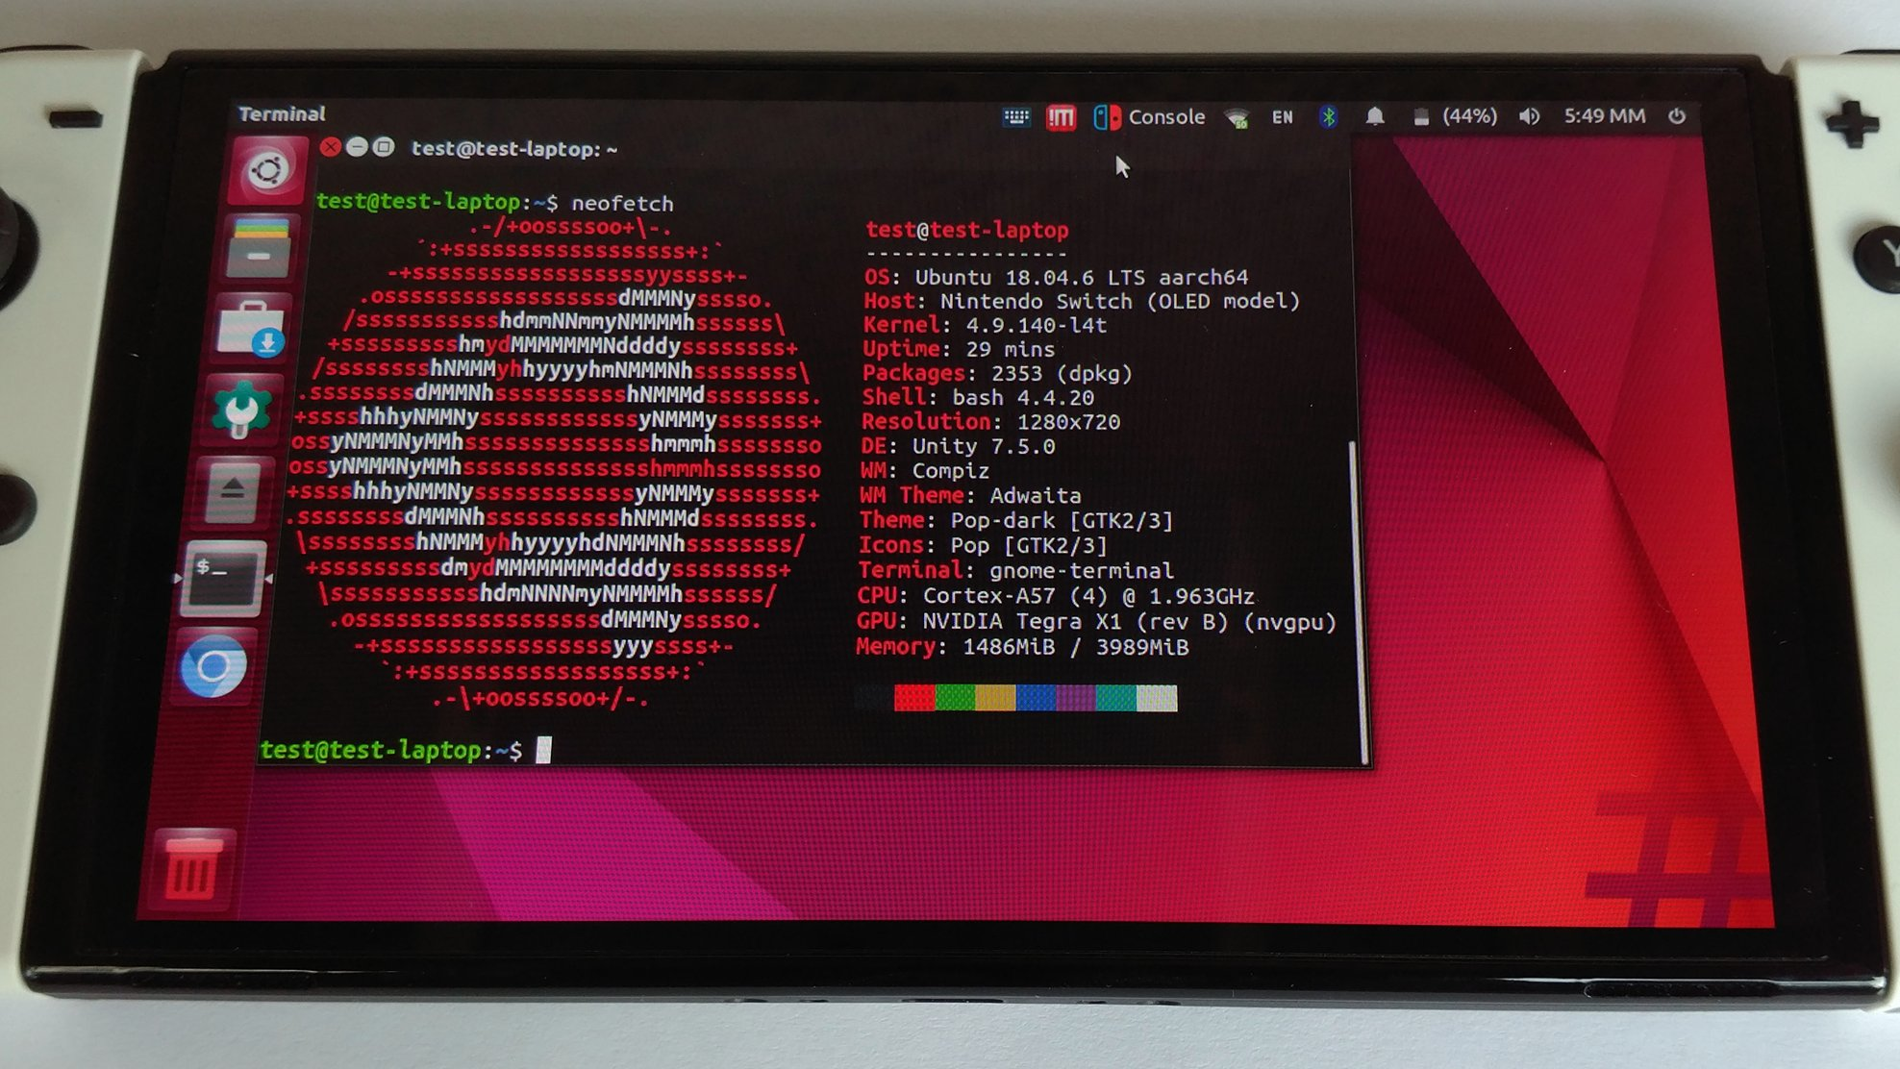
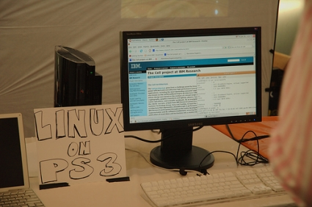
Emulation Meme
Broke: emulating retro consoles on Linux
Woke: jailbreaking your console and installing Linux

Slide 9
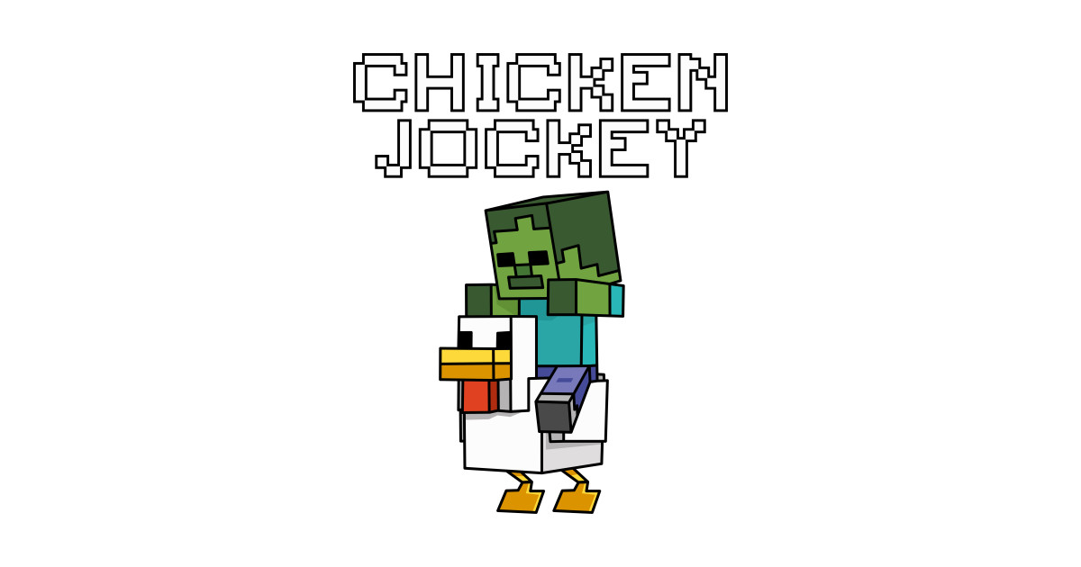
Games Written in High-Level Languages
Doki Doki Literature Club: Written with Ren’Py, a visual novel engine for Python. Python’s runtime is cross-platform
Minecraft (Java Edition): the JRE (Java Runtime Environment) is also cross-platform
Modern game engines
Unity
Godot
Unreal Engine
X

Slide 10
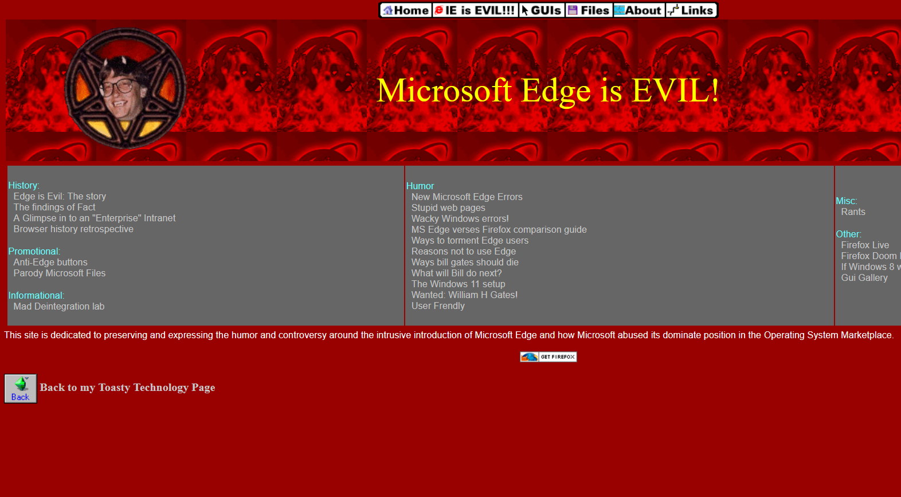
Warning: the following slides will
mention proprietary software
😱

Slide 11
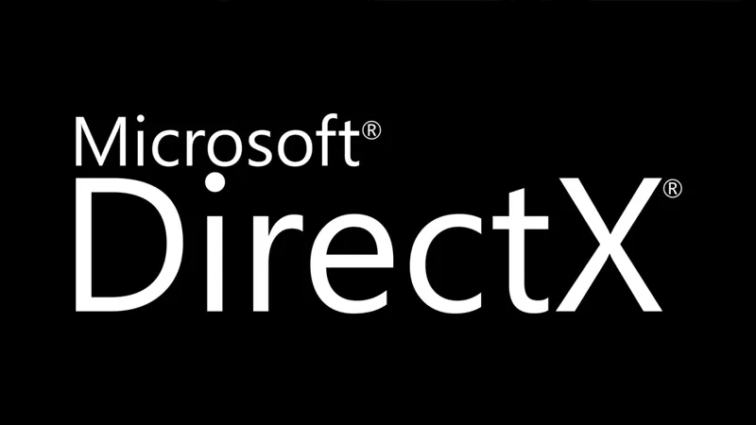
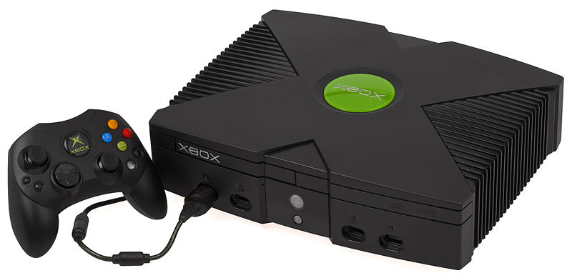
Why Are Some Games Windows Exclusive?
You have all the right hardware, yet your games require you to be on Windows...?
Windows games use DirectX
Microsoft’s multimedia API (audio, 3D graphics, etc.)
The “X” in Xbox
Meanwhile, Linux and mobile have generally used OpenGL, and now Vulkan
Both of these are cross-platform
Why was DirectX preferred historically?
Mature ecosystem
Legacy code
Bigger market share

Slide 12
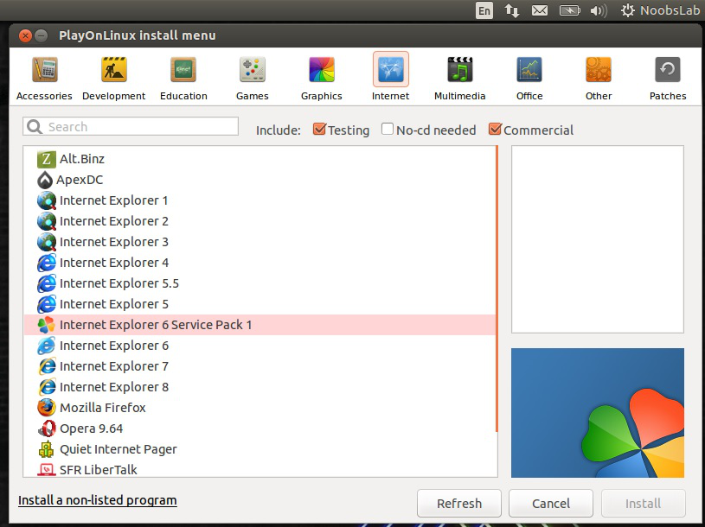
Windows Software on Linux: The Old Days
WINE: “Wine’s Not an Emulator” – compatibility layer that reimplements Windows shared libraries (DLLs)
Visual C/C++ programs
PlayOnLinux: a graphical WINE wrapper
Mono: Run older .NET applications on Linux
C#, Visual Basic programs
Basically supplanted by Microsoft’s newer .NET Core, which natively supports Linux

Slide 13
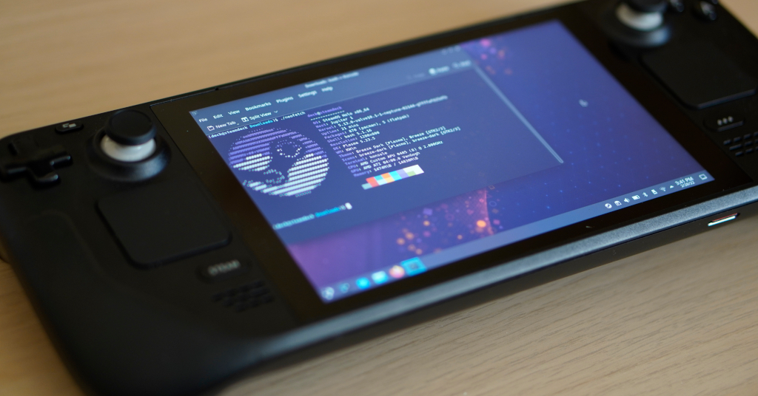
An Unexpected Ally: Valve Software
Valve Software is a video game company founded by ex-Microsoft employees
Their handheld console, the Steam Deck, runs on SteamOS, which is based on Arch Linux
Developing Proton, which is like Wine + DXVK (DirectX on Vulkan)
Now, even the corporate world is advancing gaming on Linux

Slide 14
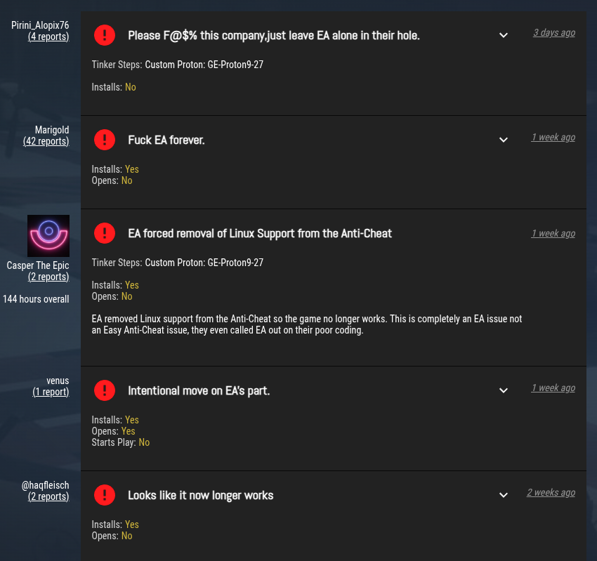
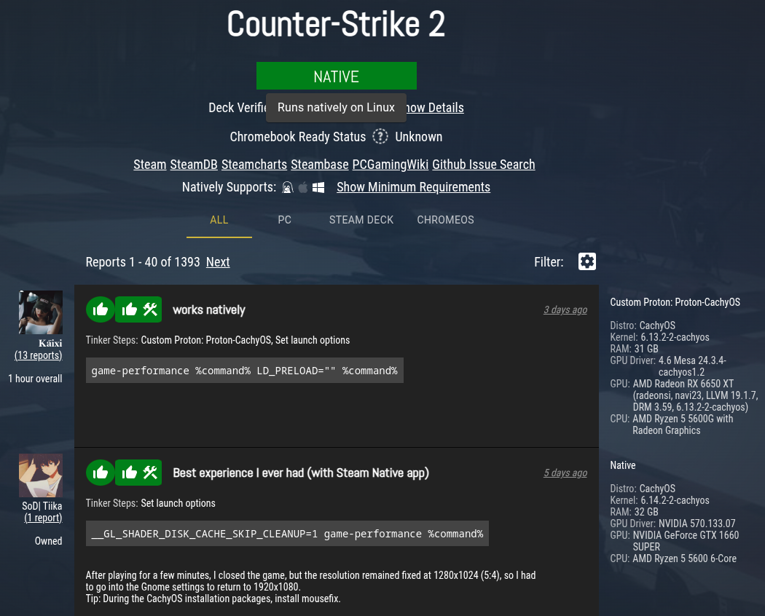
Just How Good is Proton?
ProtonDB is a community-run database of games that work with Proton
Seems like a majority of issues stem from anti-cheat (glorified spyware)

Slide 15
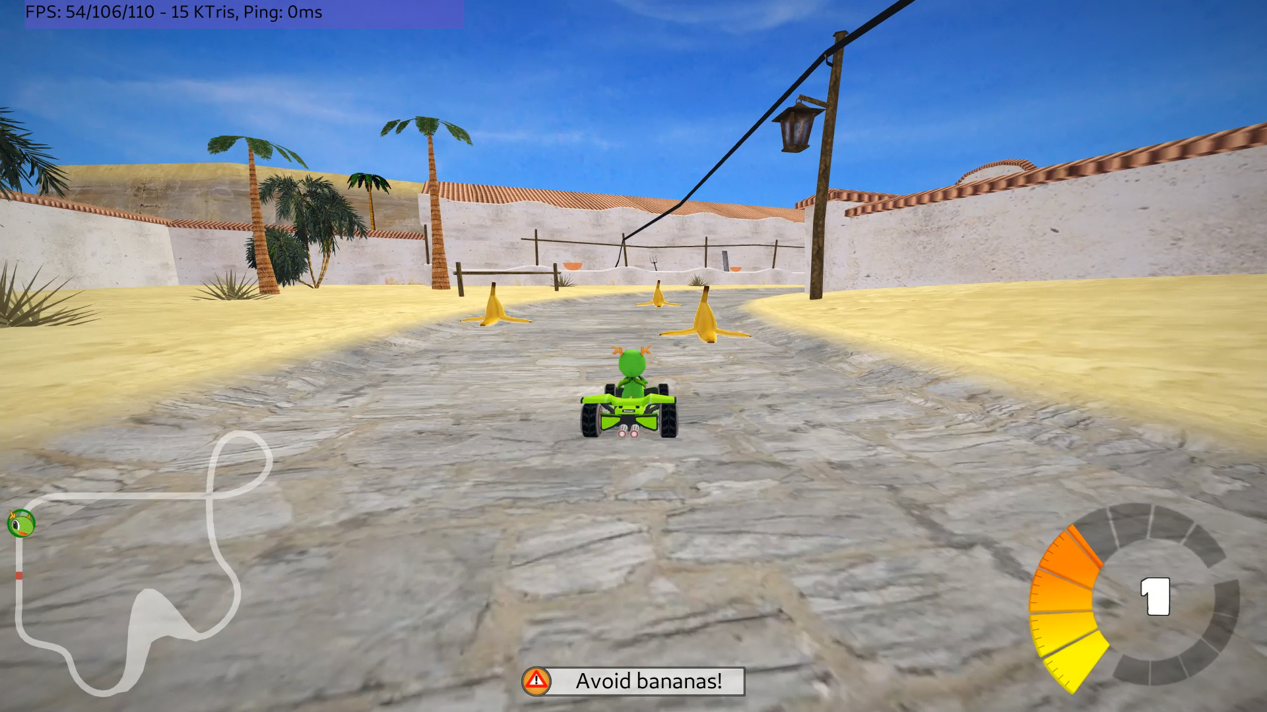
SuperTuxKart time!

